Slide 1
Delta Group
Data/IT job market analysis

Slide 2
Team members
Tue Nguyen
Giordano Vitale
Enrico Darra
Emile Rahal

Slide 3
Outline
Overall workflow
Scope of the project
Analysis of jobs
Analysis of organizations
Analysis of candidates & employment history
Regression analysis of salary based on job details
Job and candidate clustering and matching
Future work
Q & A

Slide 4
Overall workflow

Slide 5
Overall workflow
Analyze raw data
Identify useful columns
Define scope of the project
Finalize the results
Perform analyses on cleaned data
Clean and standardize data

Slide 6
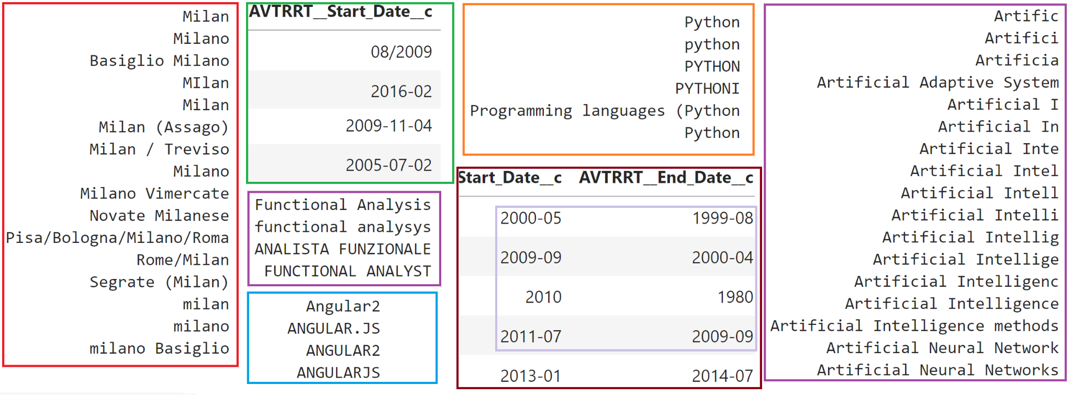
Example 1 - Messy data

Slide 7
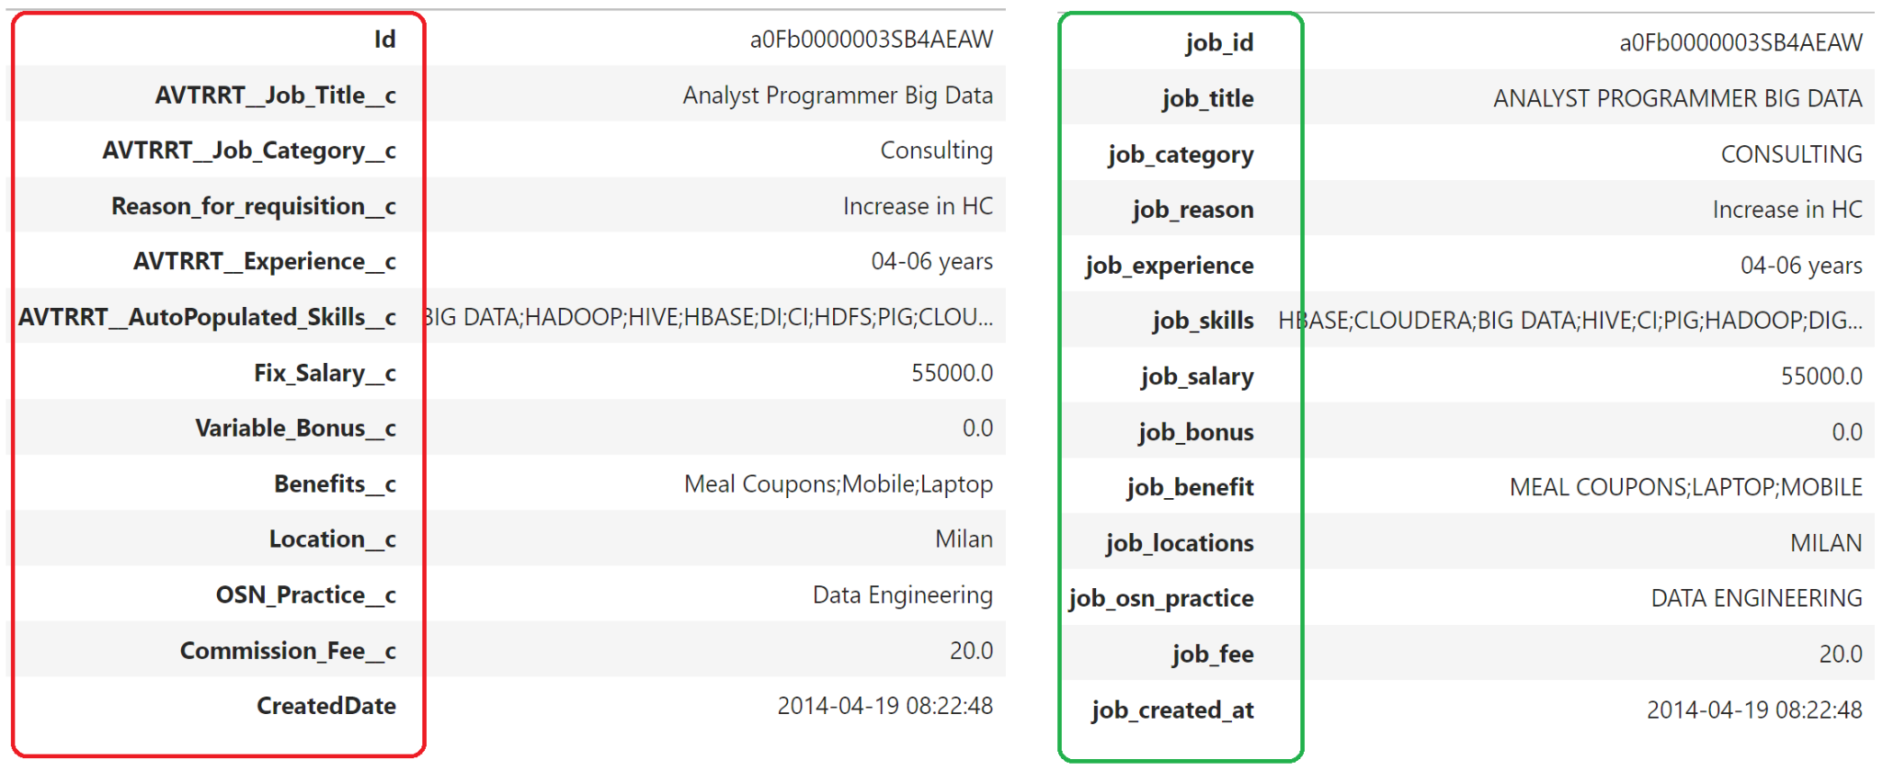
Example 2 - Original vs. Cleaned

Slide 8
Example 3 - Final data
data/original/ | data/cleaned/
Account_Anonymized.csv | organizations.feather
AVTRRT__Job_Anonymized.csv | jobs.feather
Contact_Anonymized.csv | candidates.feather
AVTRRT__Employment_History__Anonymized.csv | histories.feather
AVTRRT__Job_Applicant__Anonymized.csv | applications.feather

Slide 9
Project’s scope

Slide 10
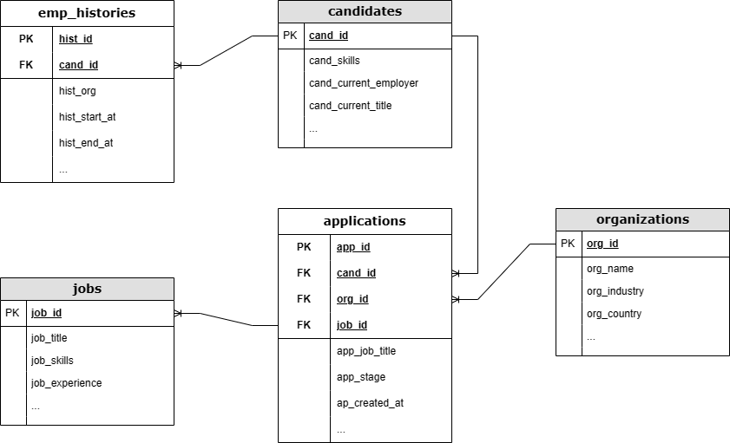
ERD
Notes:
JOB: most meaningful table

Slide 11
Analysis of jobs

Slide 12
General insights

Slide 13
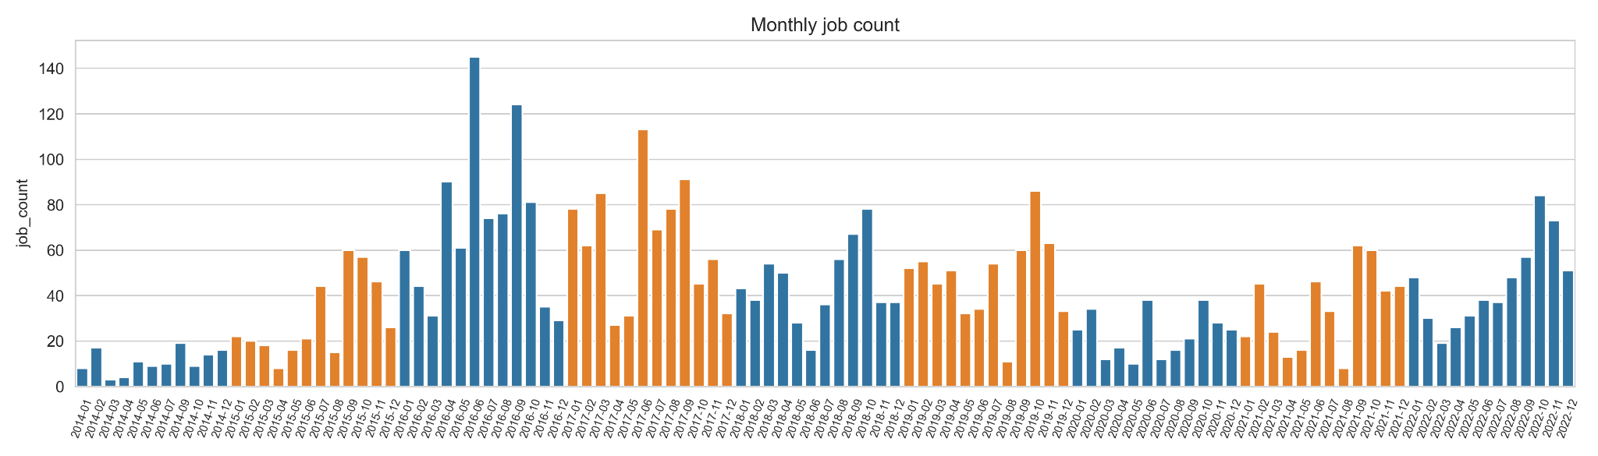
Monthly job count
Notes:
We don’t expect this cycle reflect the trend in the market. Pattern not so clear even tho it looks like there are more jobs at the beginning of the year and the end
we want to analyse if there is a seasonal pattern or a cycle in the market: the pattern is not so clear... we can see that people apply more in the beginning or in the end of the year, but the pattern is not very clear.
It may be that the way the company collects data influence this fact.

Slide 14
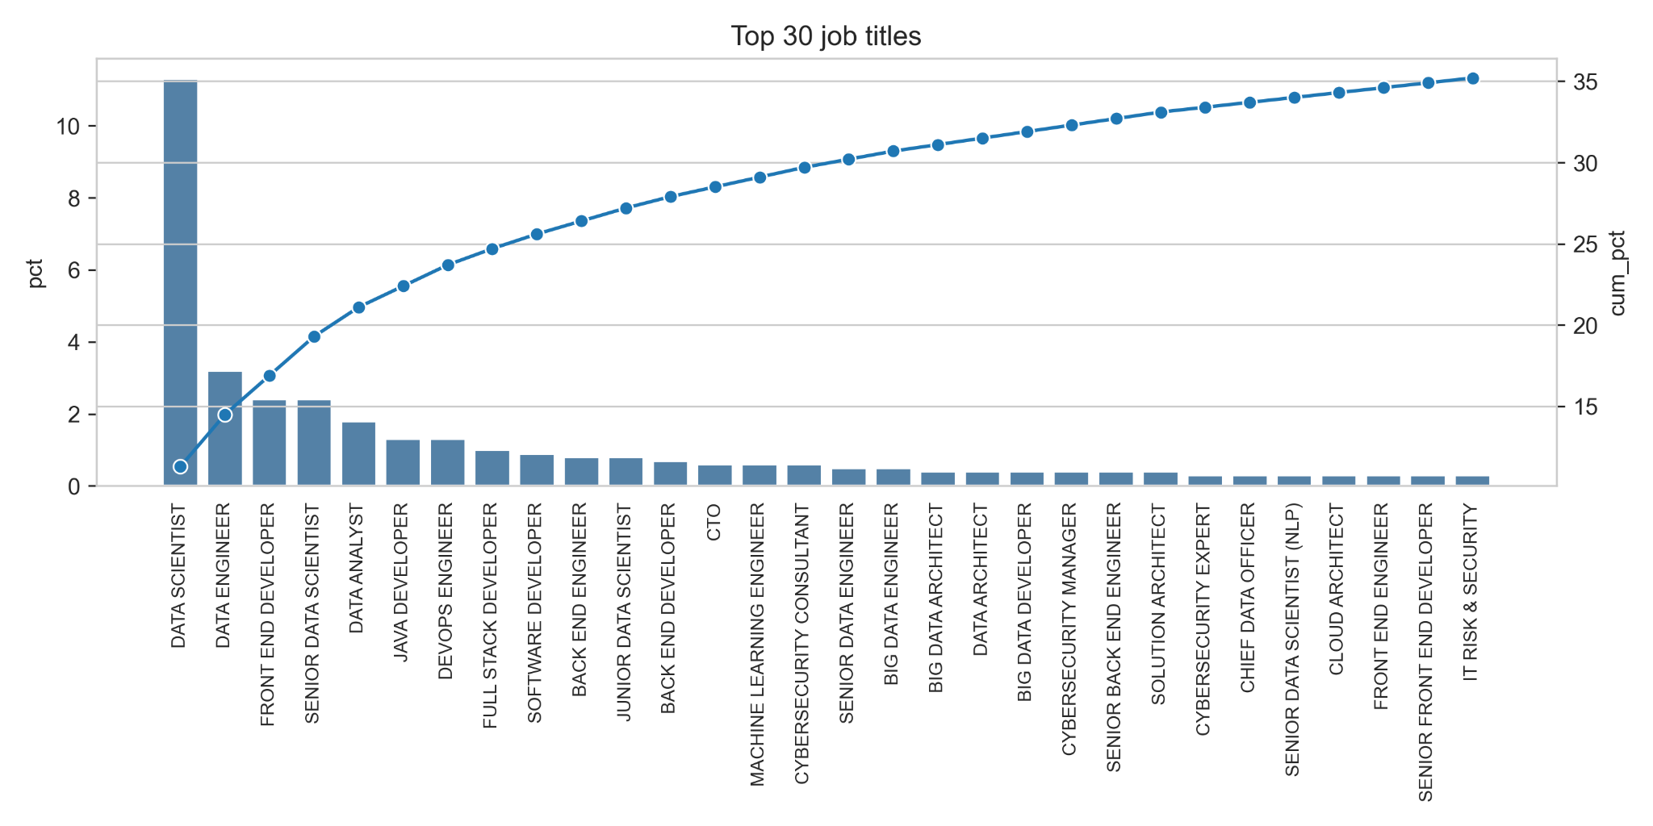
Top job titles
Notes:
Cum_pct: 80/20 principle: 20% of our jobs come from just the top5: apply for one of the top5 gives better chances ‘cause there’re more jobs.

Slide 15
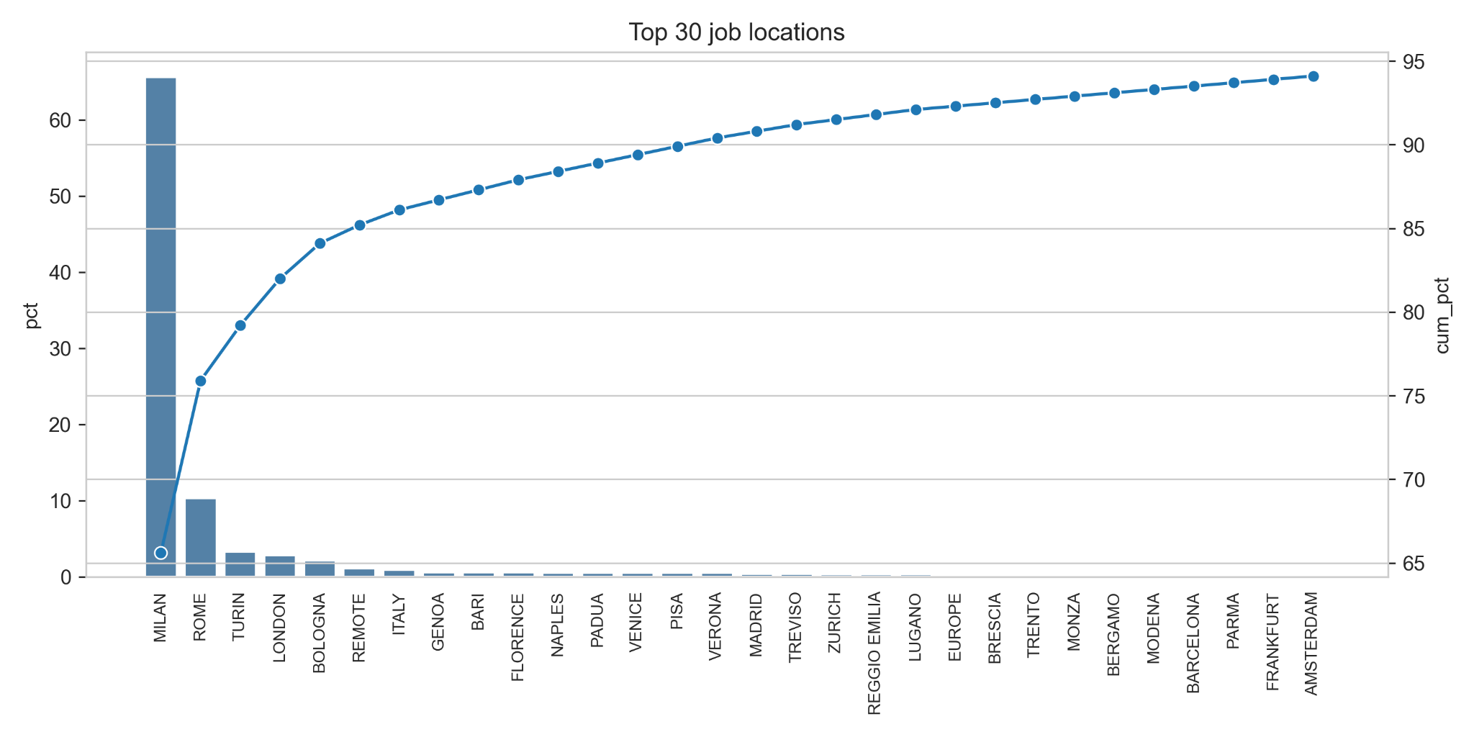
Top job locations
Notes:
90% of the jobs come from Italy (Milan number 1), just a few outside

Slide 16
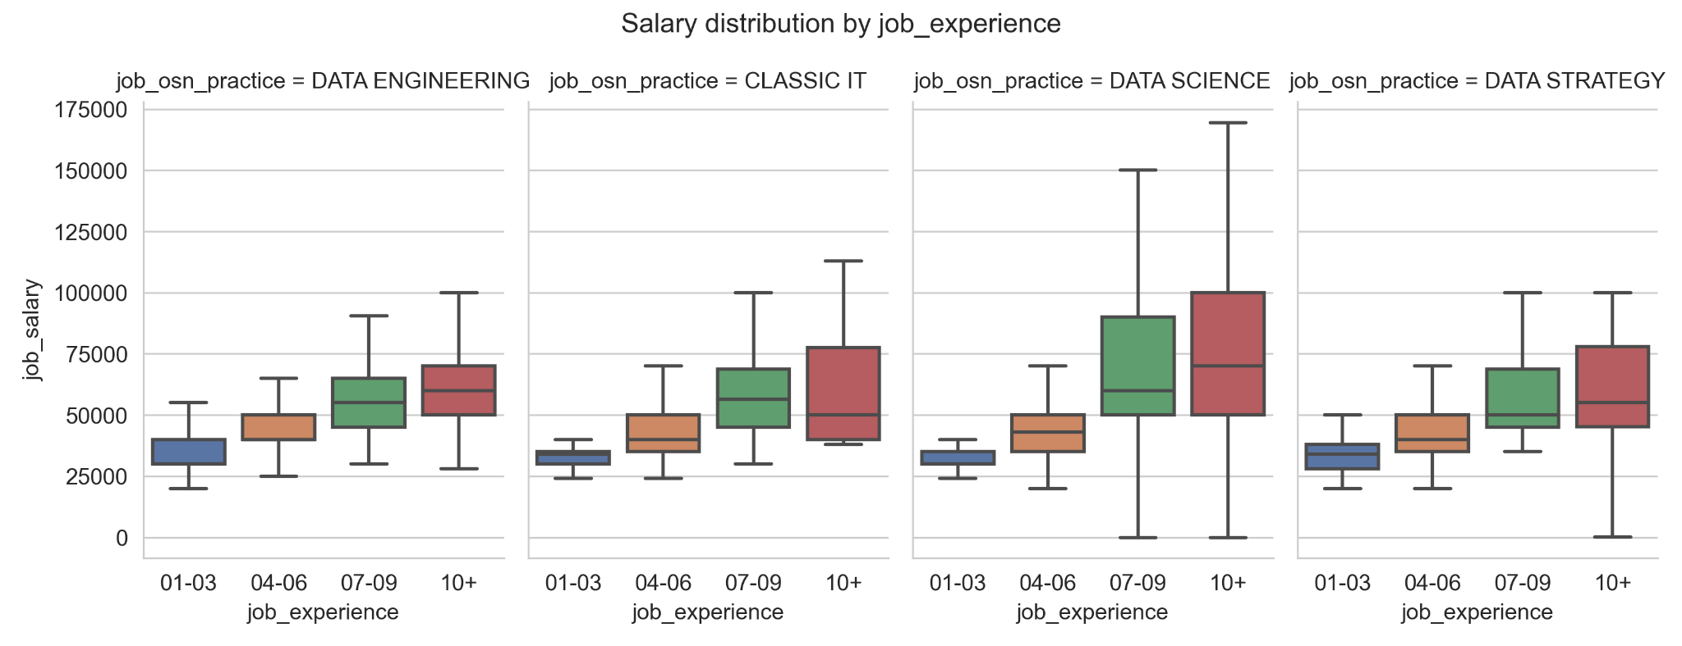
Compensation by experience
Notes:
Dimensions: experience and job category.
Data upward trending: (as expected). Bigger variations comes with the later stage of experiences (probably due to increased responsibility and maybe managerial tasks)

Slide 17
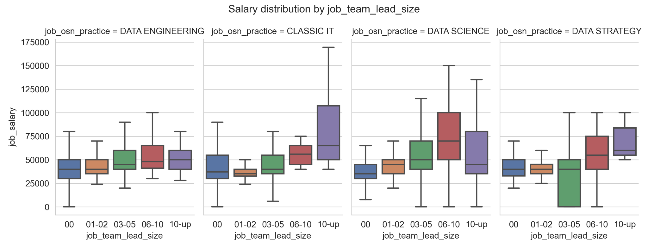
Compensation by team size led
Notes:
Number of ppl u gonna lead in the job. The trends are not clear

Slide 18
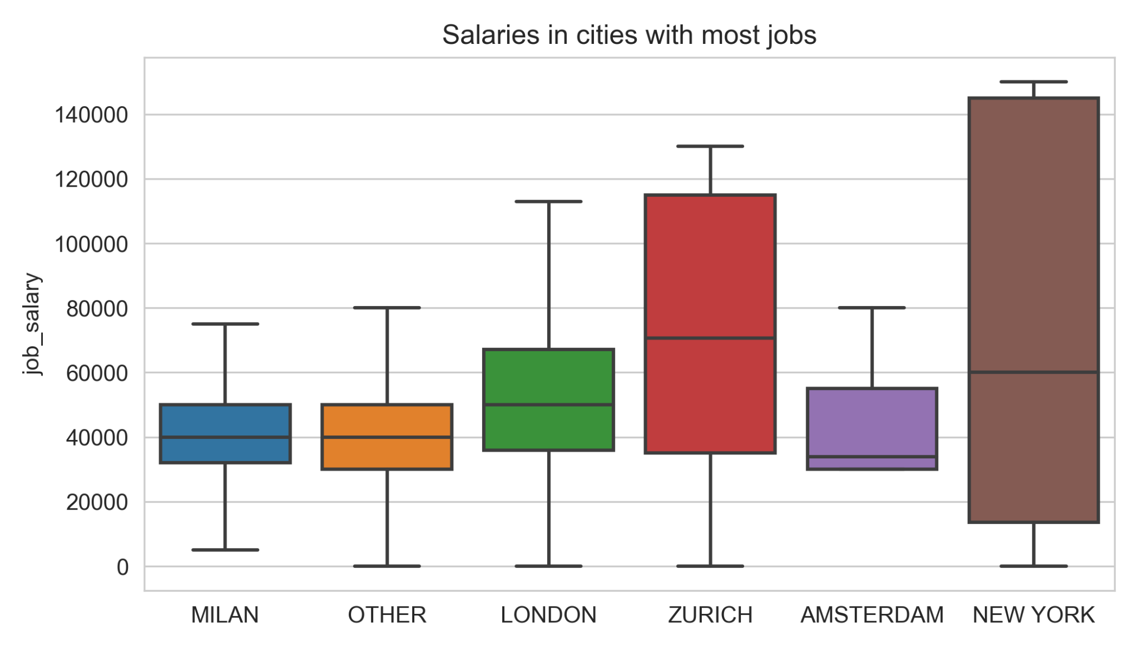
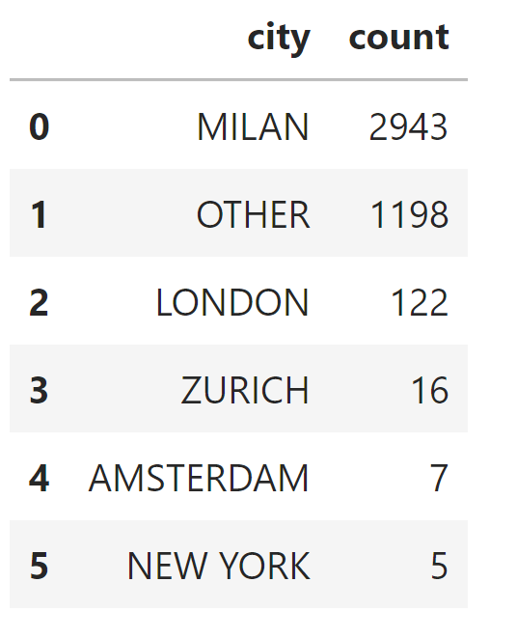
Compensation in cities with most jobs
Notes:
Tricky because, beyond Milan and London, other cities have very few observations (point out high variations for Zurich, NY)
Milan and Other = no salary difference even tho life’s cost higher here
London/NY/Zurich data has been standardized to Euro

Slide 19
Top desired skills

Slide 20
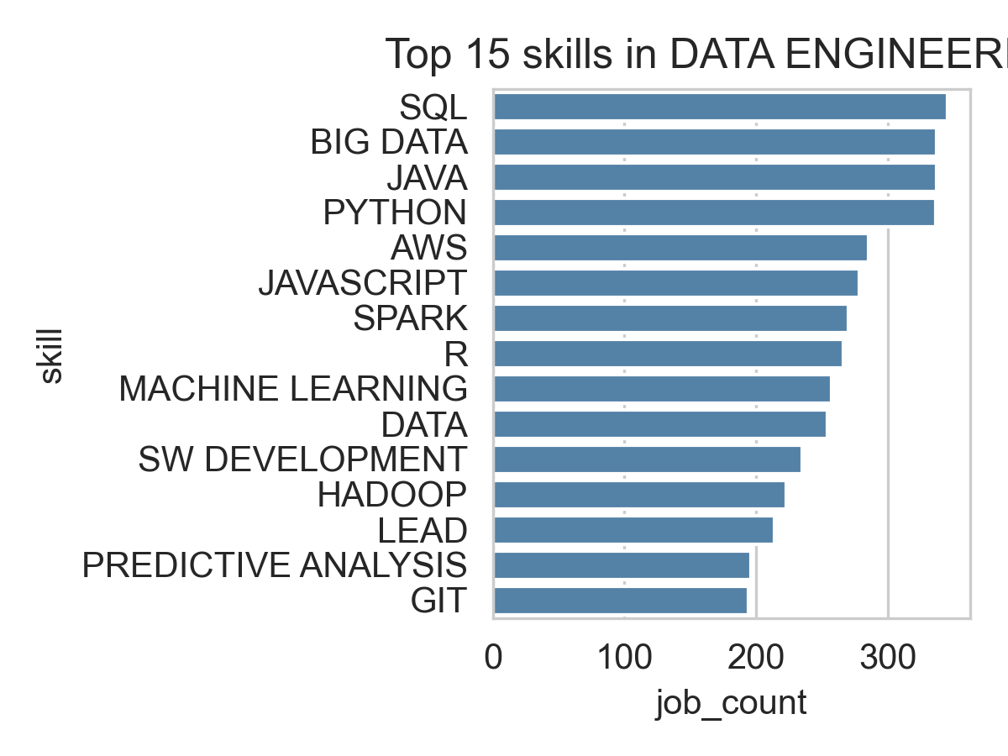
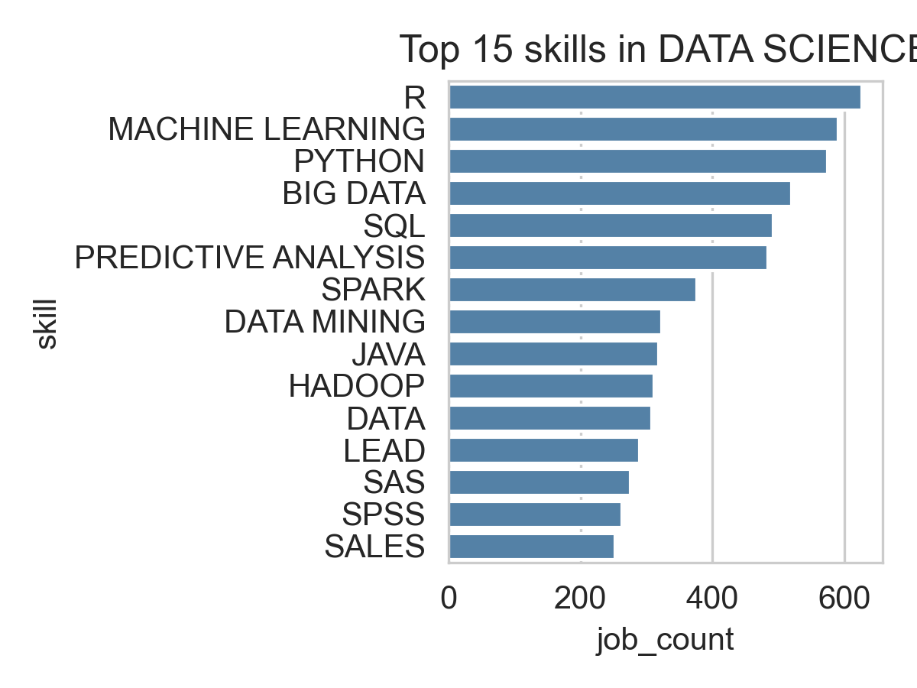
Top skills in DE and DS (by OSN practice)
Notes:
The data reflects the top skill for data engineer and data scientist very well

Slide 21
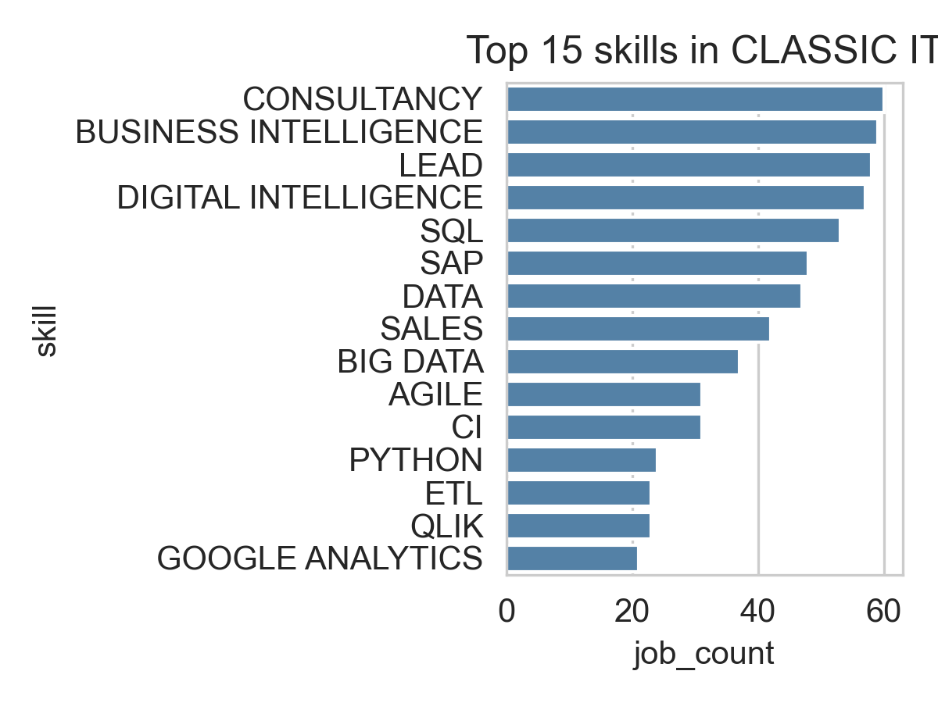
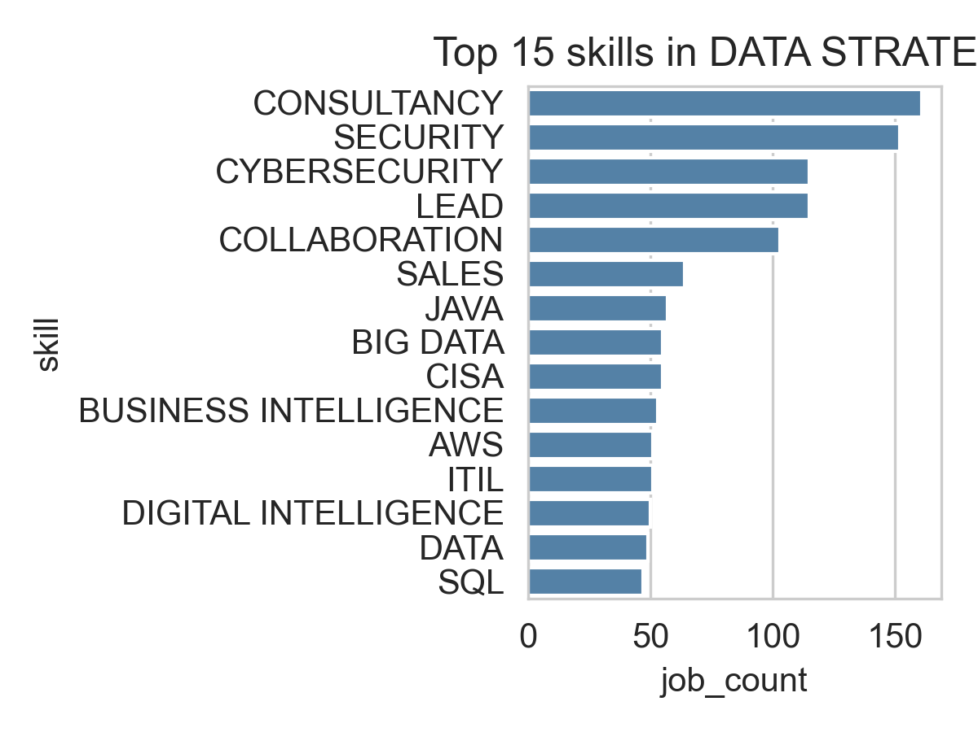
Top skills in Classic IT and Strategy (by OSN practice)
Notes:
Just 60 jobs require them skills in Classic IT (vs the 300/600 of the previous slide)

Slide 22
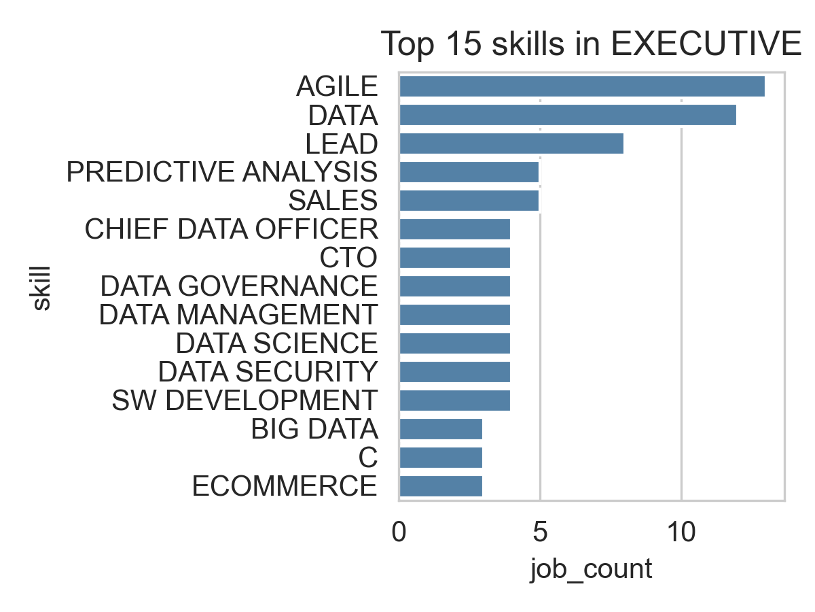
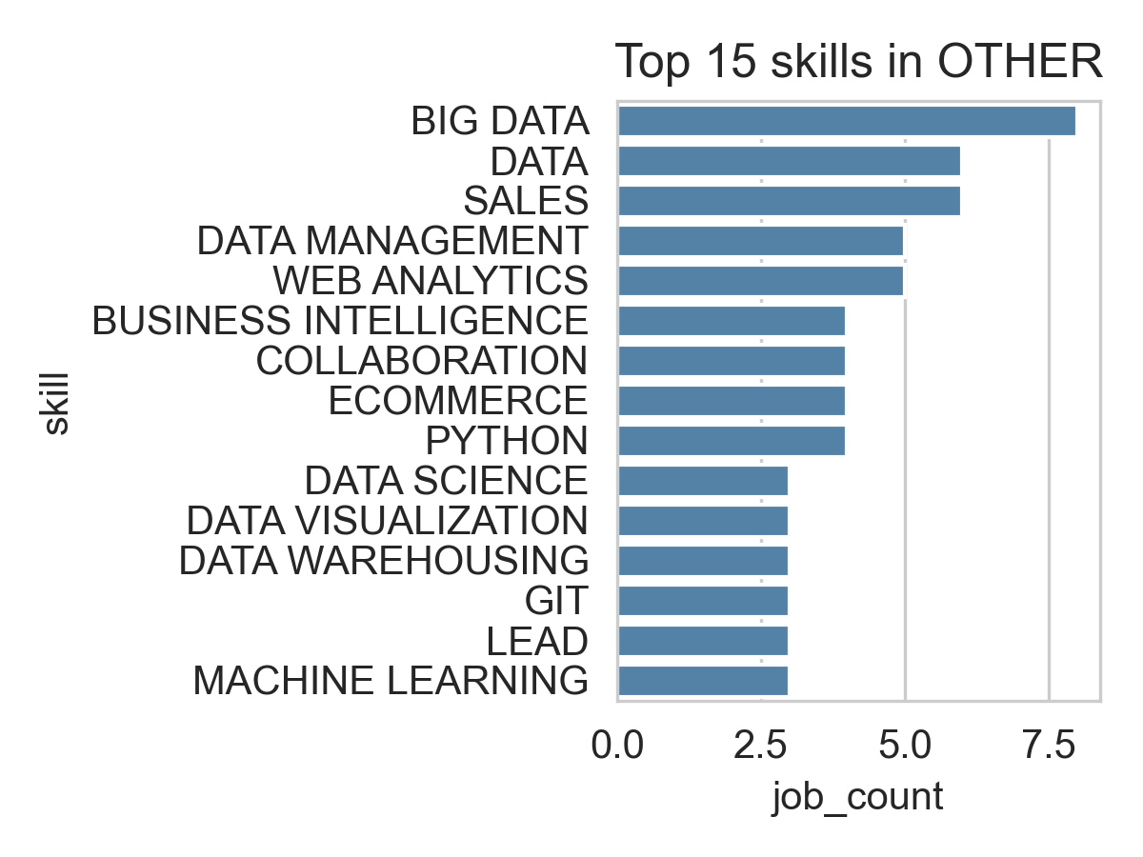
Top skills in Executive and Other (by OSN practice)

Slide 23
Skill evolution in Programming

Slide 24
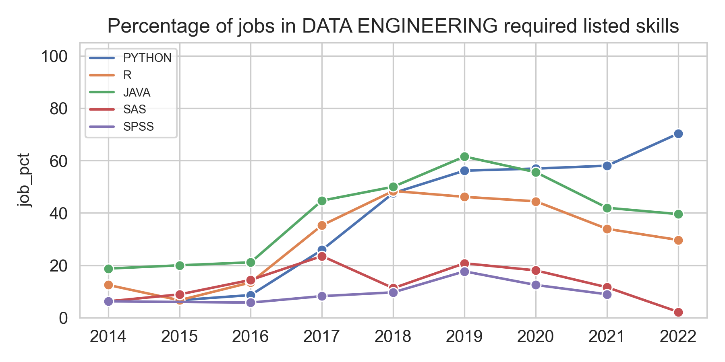
Notes:
TREND: starting 2016 Python increase rapidly (70% by 2022); downward trend for SAS and SPSS
After 2020 job became more specialized, jobs require less skills but with deeper knowledge (Python only one increasing for its various uses)

Slide 25
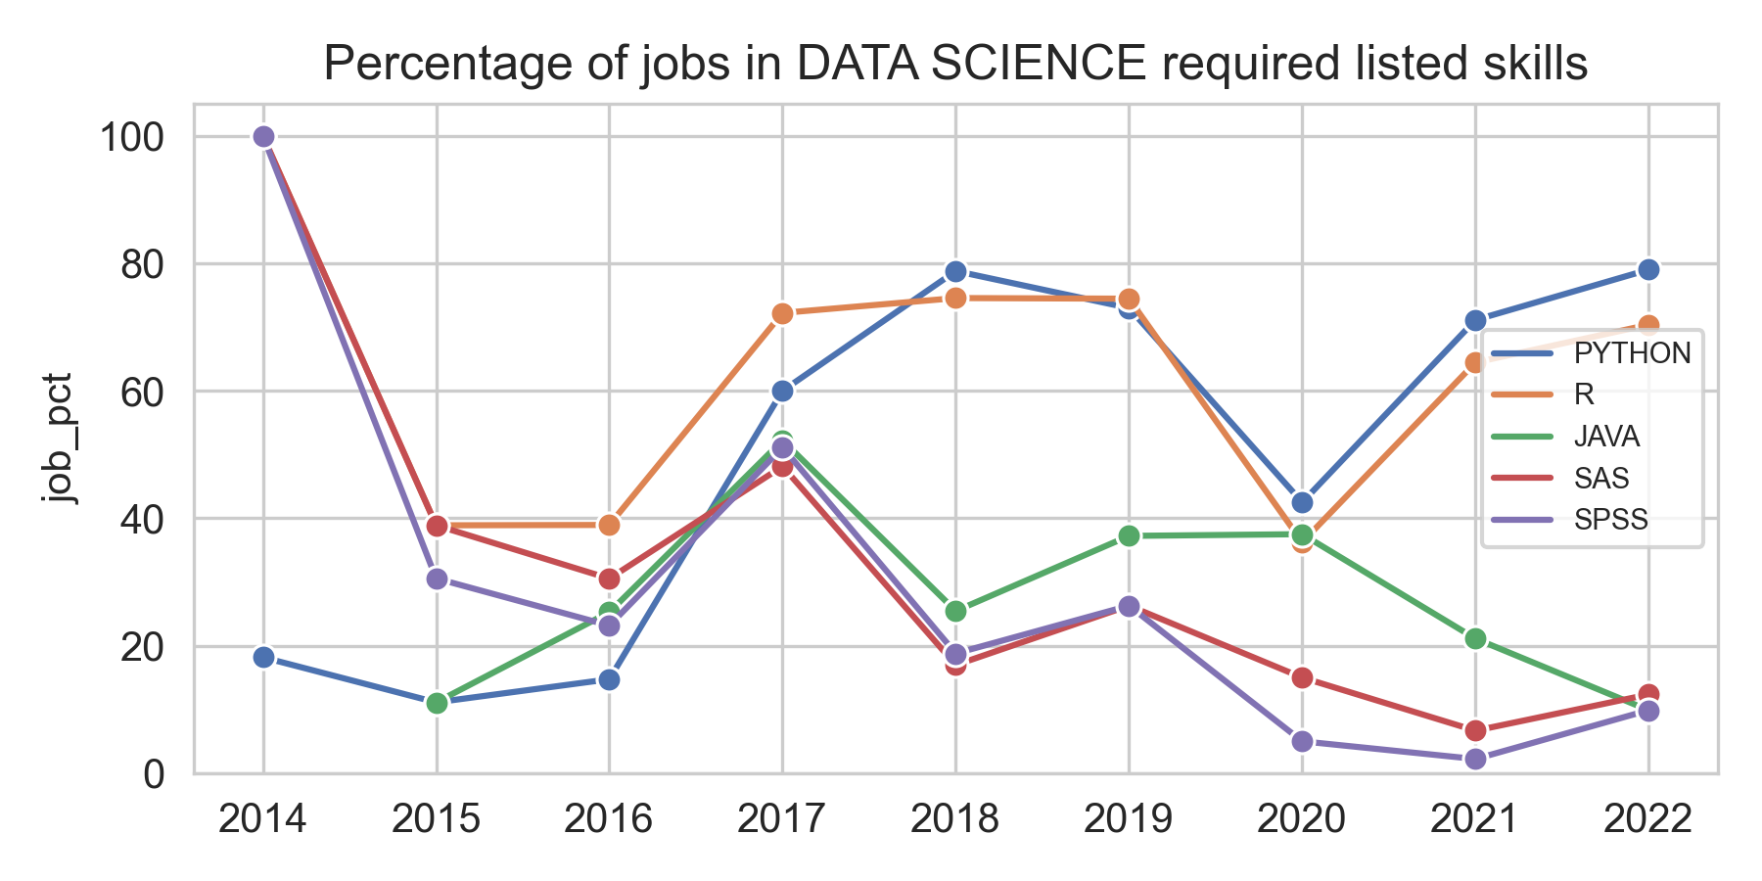
Notes:
Issue with the 2020 dip (?)
Java for software engineers, not ds, decreasing trend (also SAS SPSS)

Slide 26
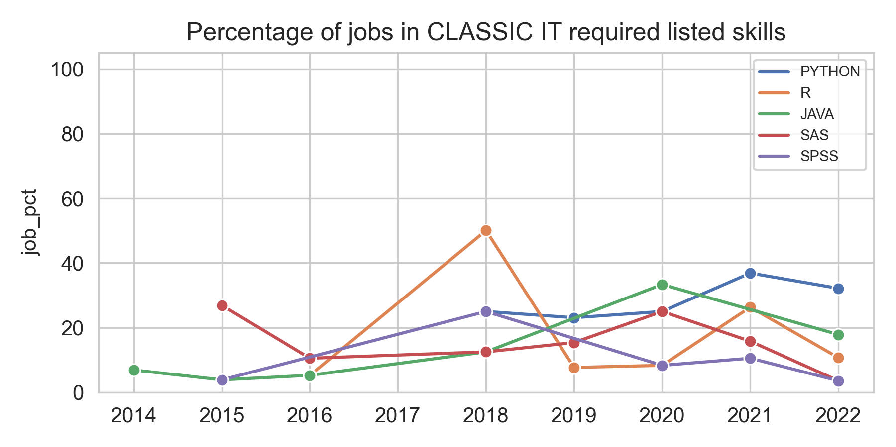
Notes:
Be quick on this (increase in py)

Slide 27
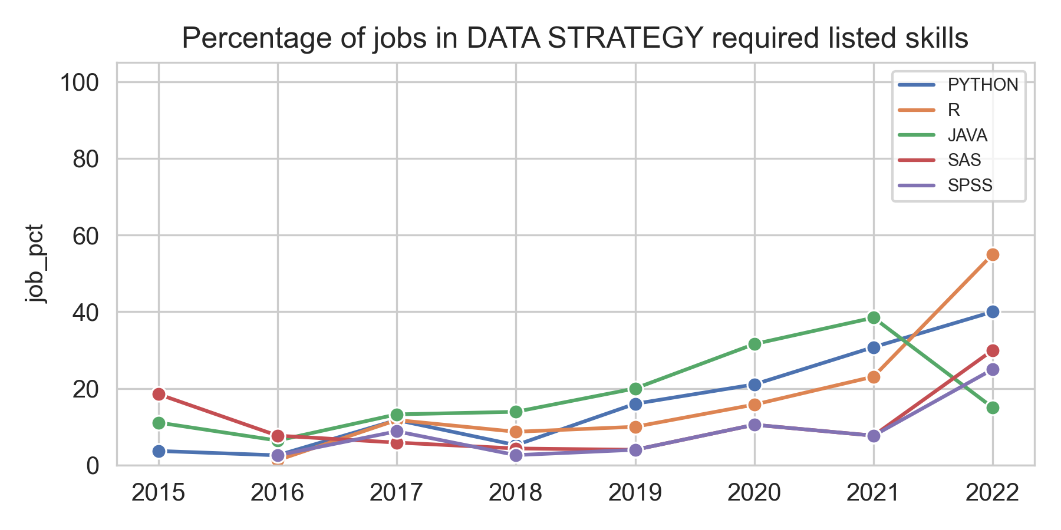
Notes:
Upward trend: w/ time the job requires a better understanding of the programming languages
What is a data strategy? A data strategy is a long-term plan that defines the technology, processes, people, and rules required to manage an organization's information assets.

Slide 28
Skill evolution in Data Management

Slide 29
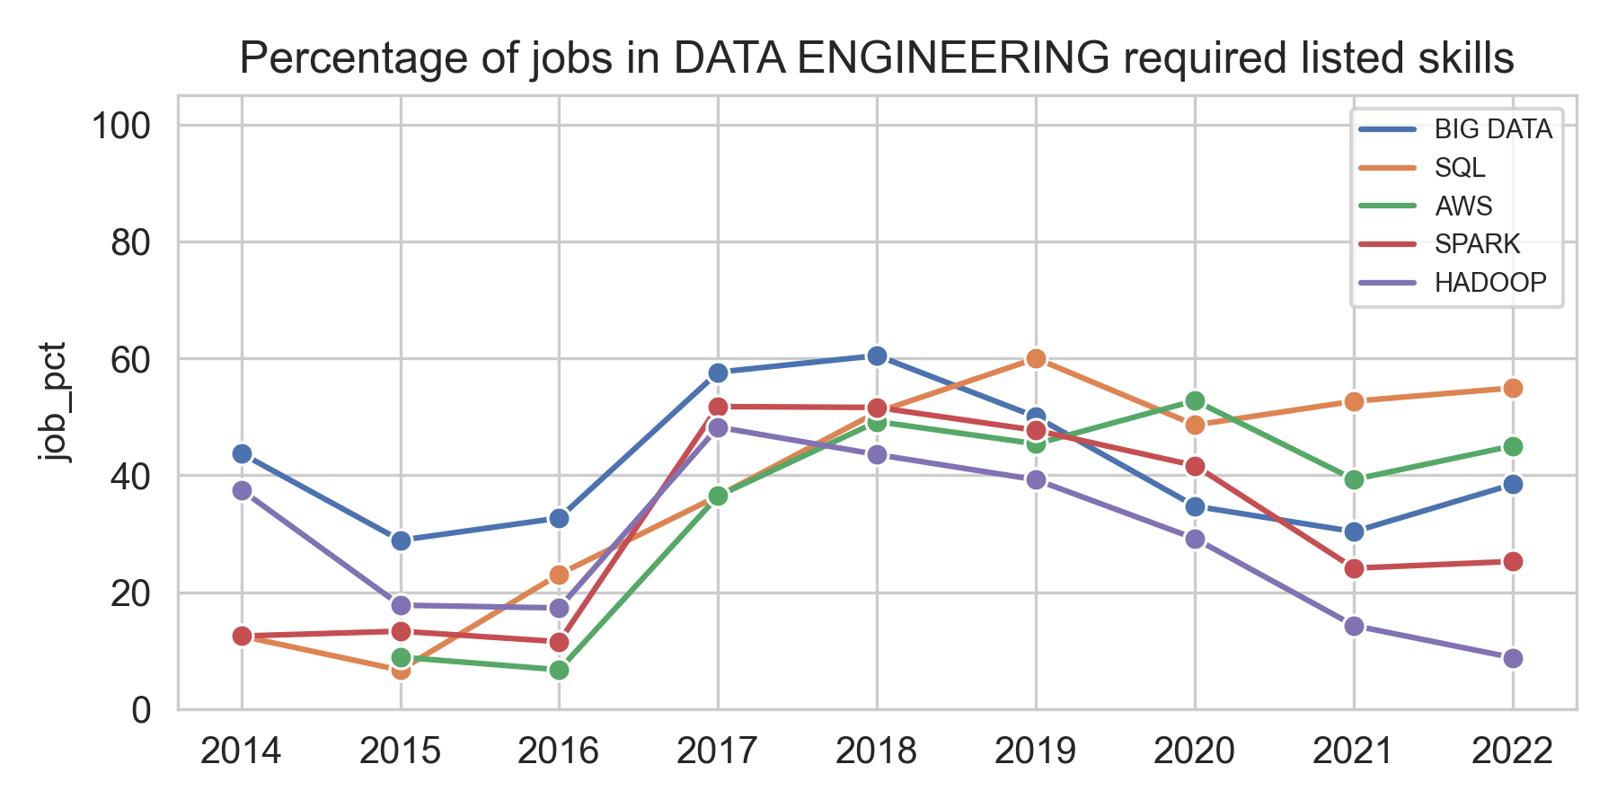
Notes:
Upward trend around 2017, then some stability, downward for Hadoop
Recent years preference for cloud database rather than making their own (decrease in Hadoop)
Stability for big data and sql
Increase early of AWS

Slide 30
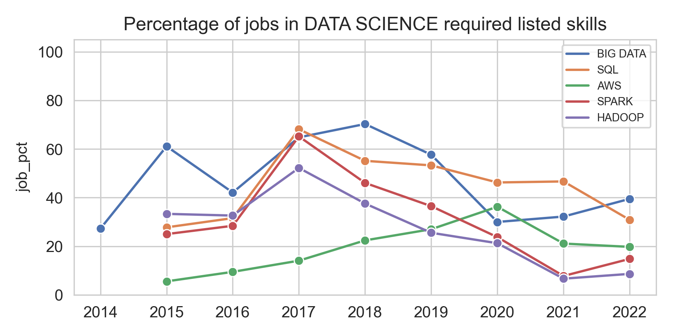
Notes:
Similar previous slide. Downward trend after 2017, data science focus more on ds skills (job specialization)
Skill for DM decreasing cuz of less engineering work

Slide 31
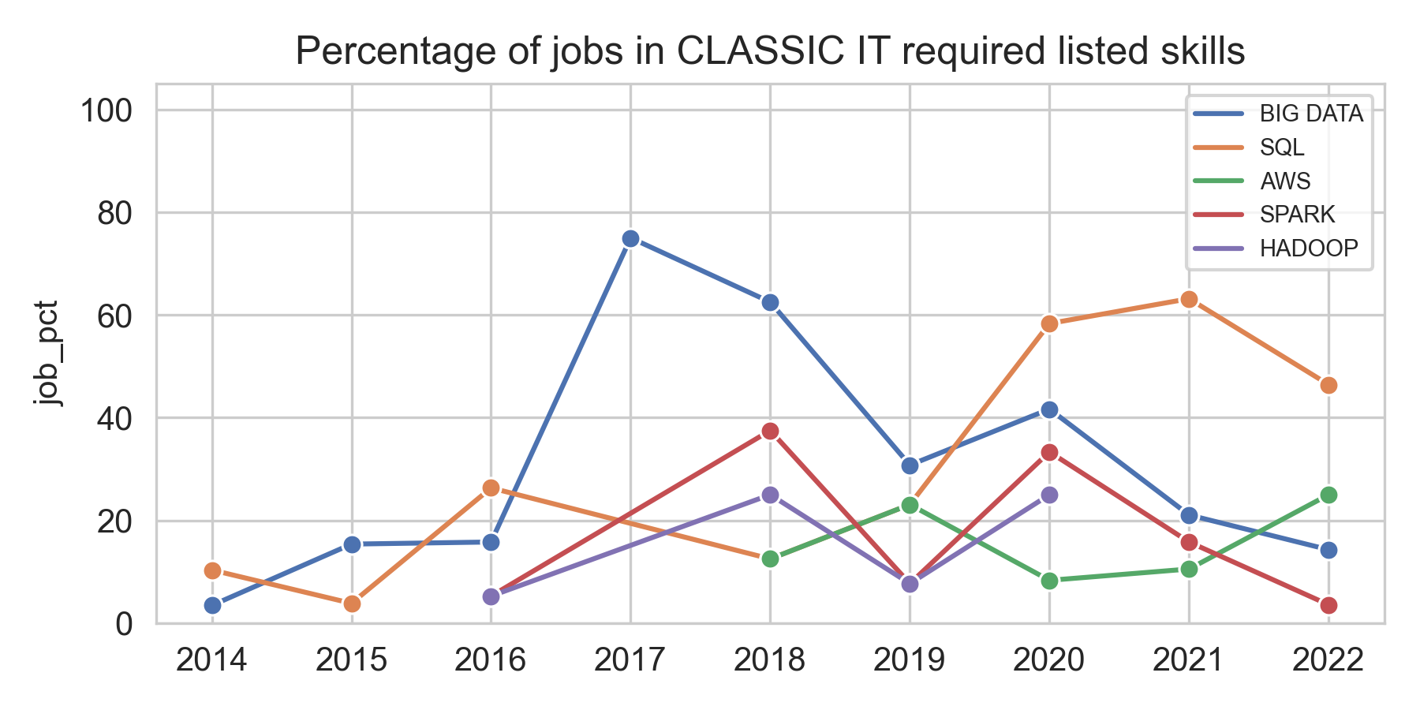
Notes:
Not a lot of data (estimates not too reliable)

Slide 32
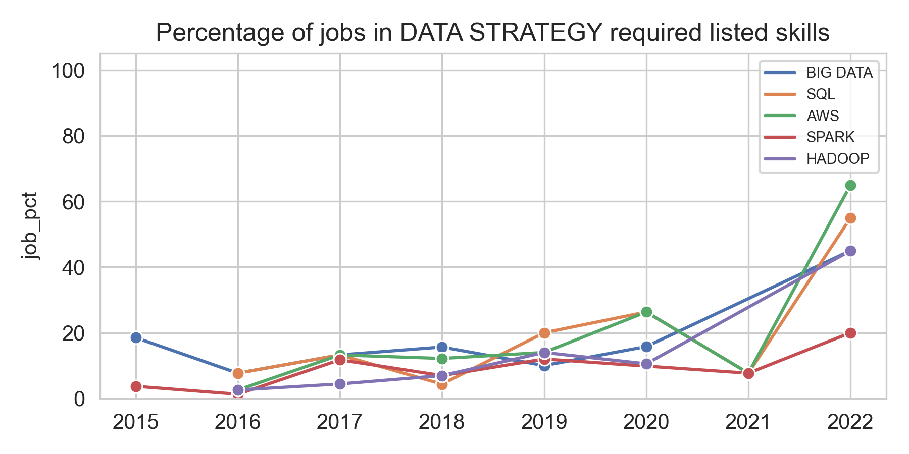
Notes:
General upward trend (know something about data management technology)
What is a data strategy? A data strategy is a long-term plan that defines the technology, processes, people, and rules required to manage an organization's information assets.

Slide 33
Skill evolution in Data Analytics

Slide 34
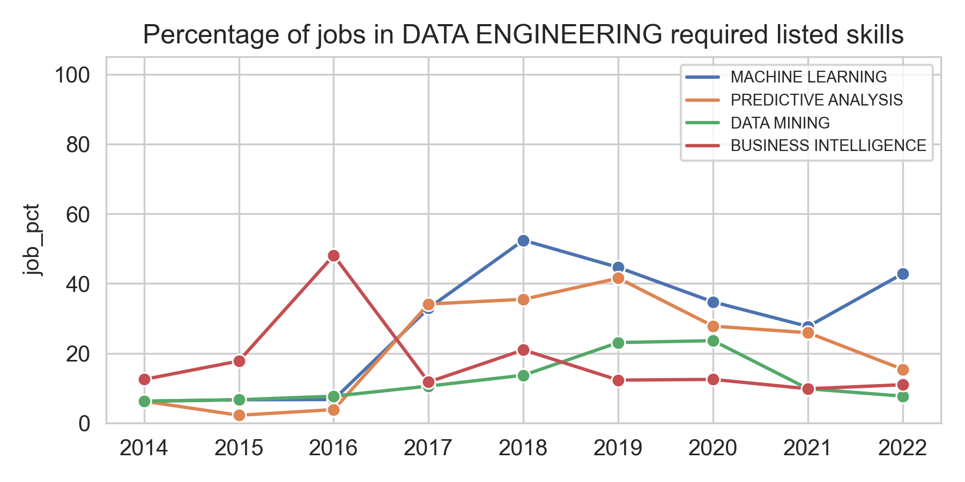
Notes:
The skills are kind of stable, not much change over time
Quick rise of ML after 2016
Downwart predict. Analysis (not an engineer job to predict)
Data mining, BI less required compared to Data Scientist

Slide 35
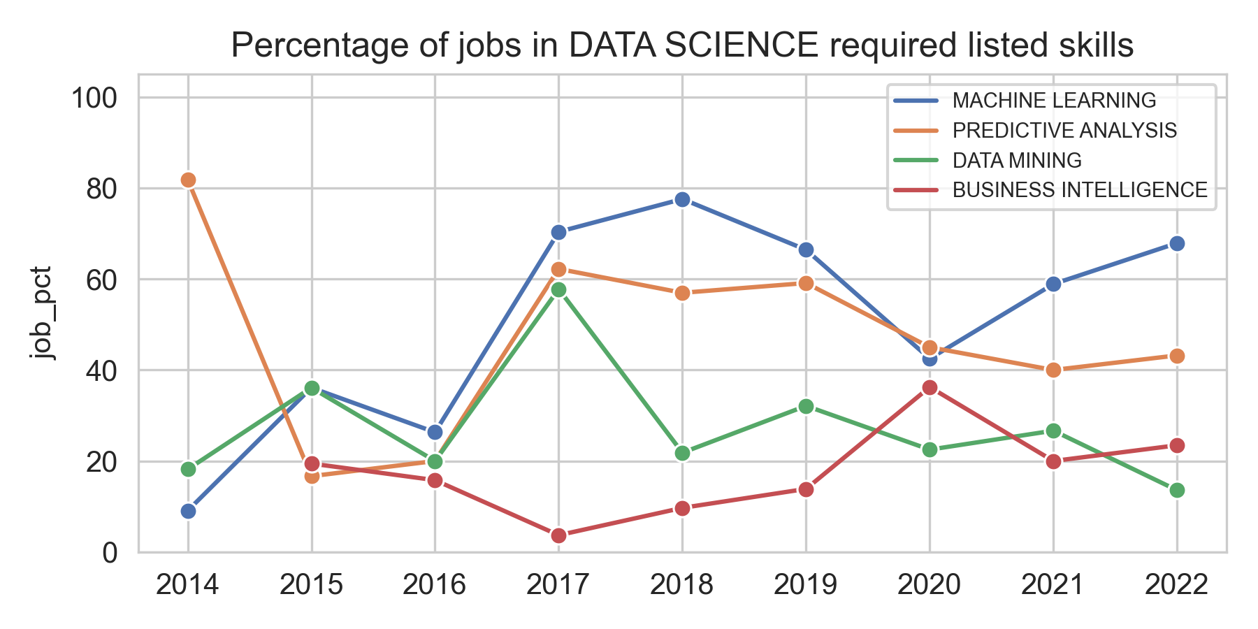
Notes:
More change over time (problem with data of 2020, why??). ML and predictive modelling very important to get a job

Slide 36
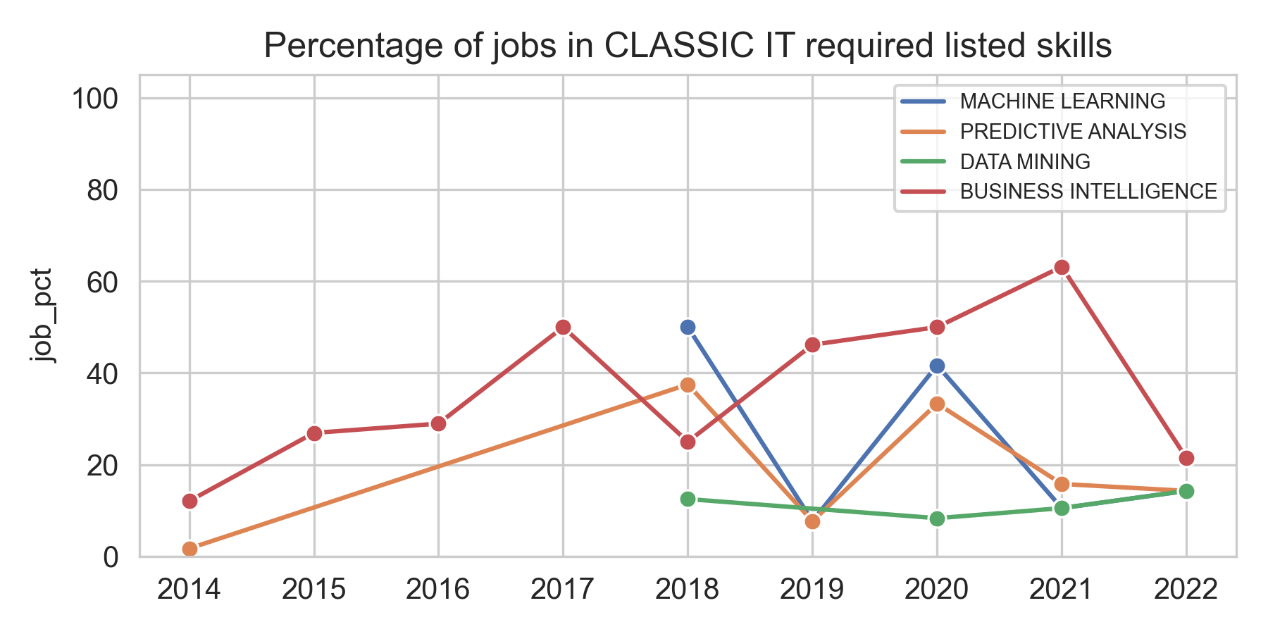
Notes:
Few data

Slide 37
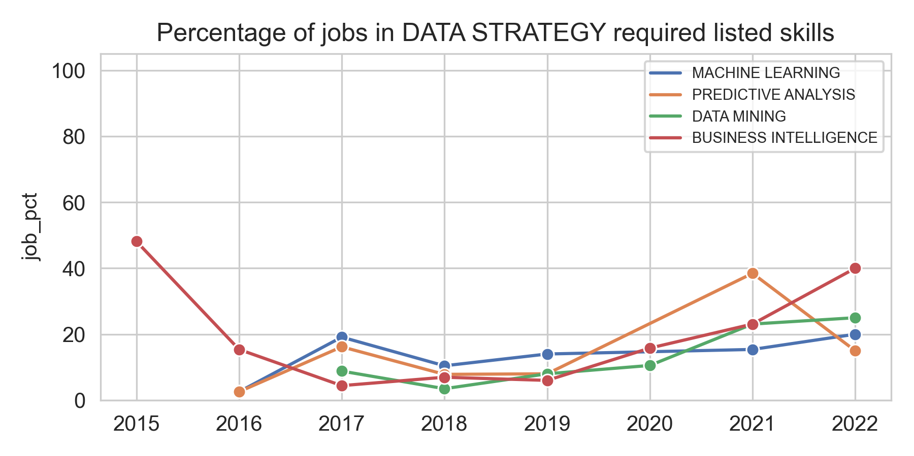
Notes:
Few data
CONCLUSIONS: We see an increasing specialization in the jobs, this means a deeper knowledge of less skills, especially for data scientist and data engineer positions.
Data strategist positions need a better understanding of programming and data management tools (no more a big-picture kind of job)

Slide 38
Analysis of organizations

Slide 39
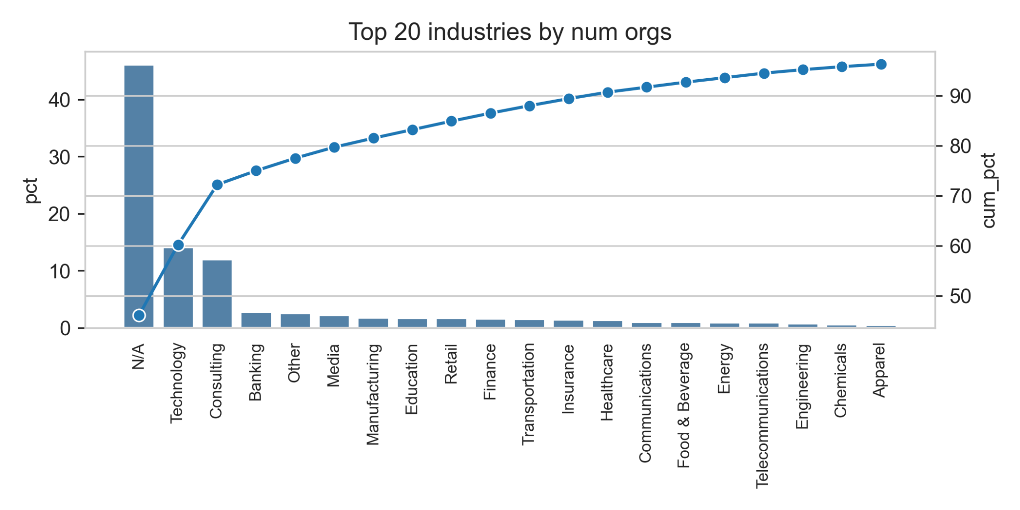
Top industries
Notes:
Top 3: tech, consultancy and bank

Slide 40
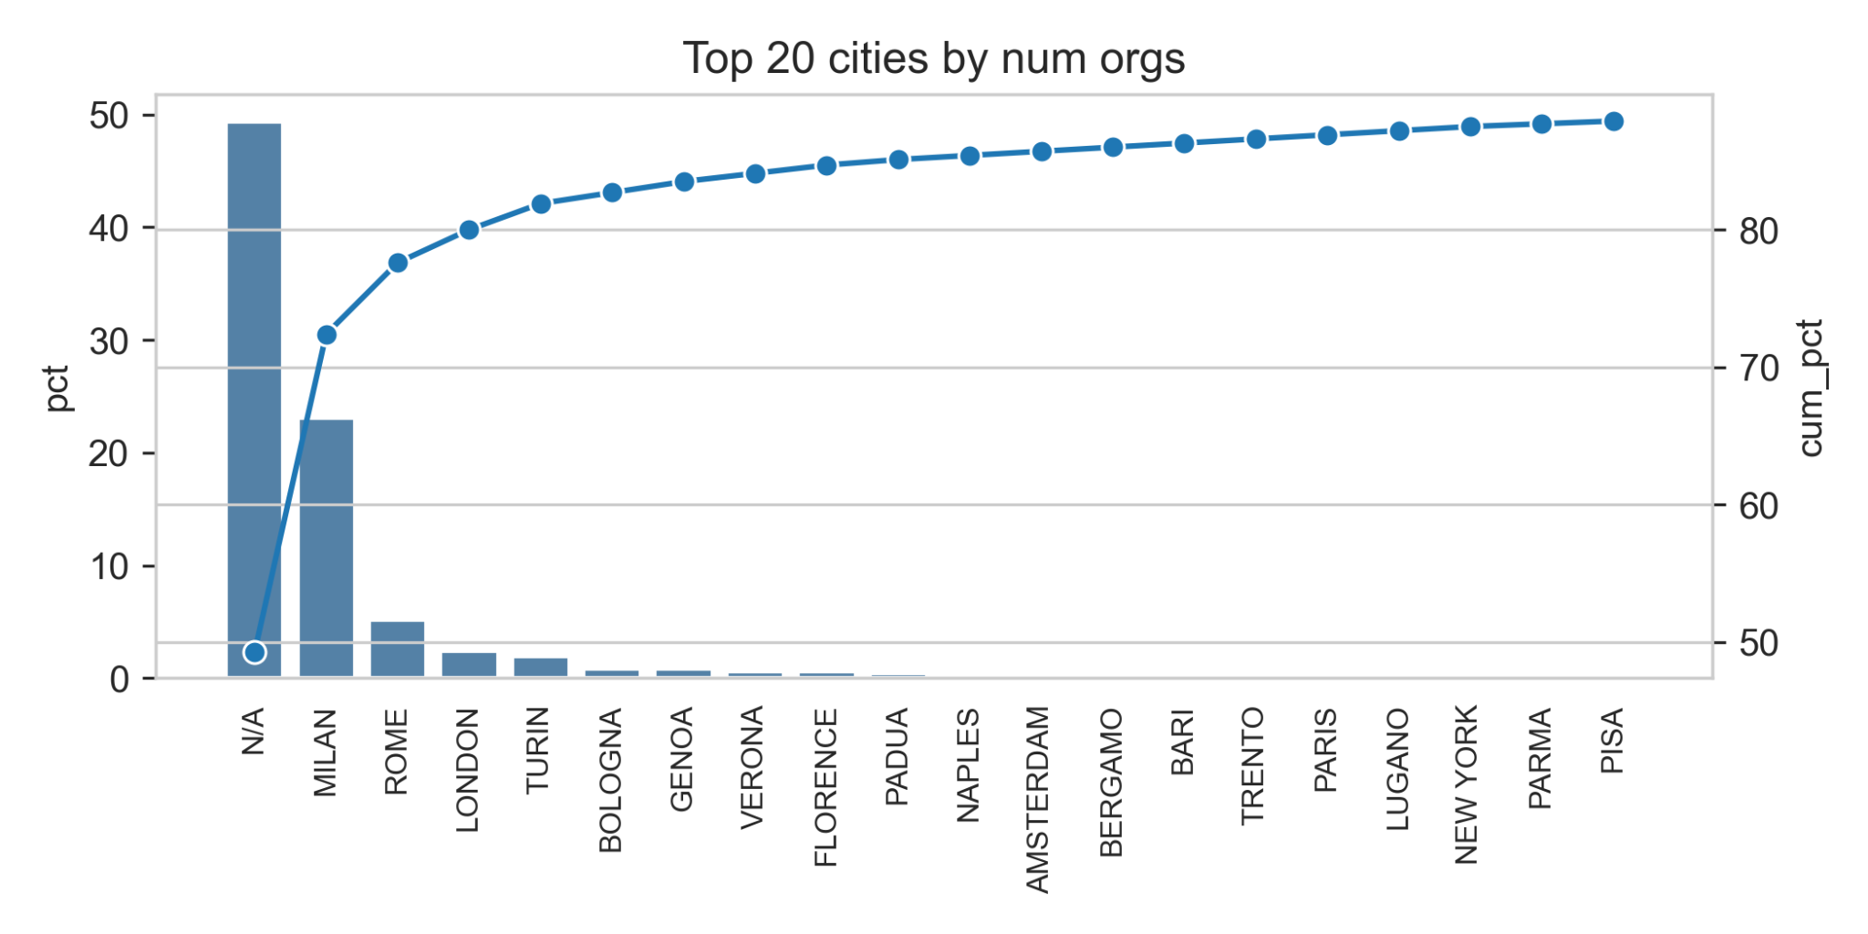
Top cities
Notes:
Nearly half the data are missing

Slide 41
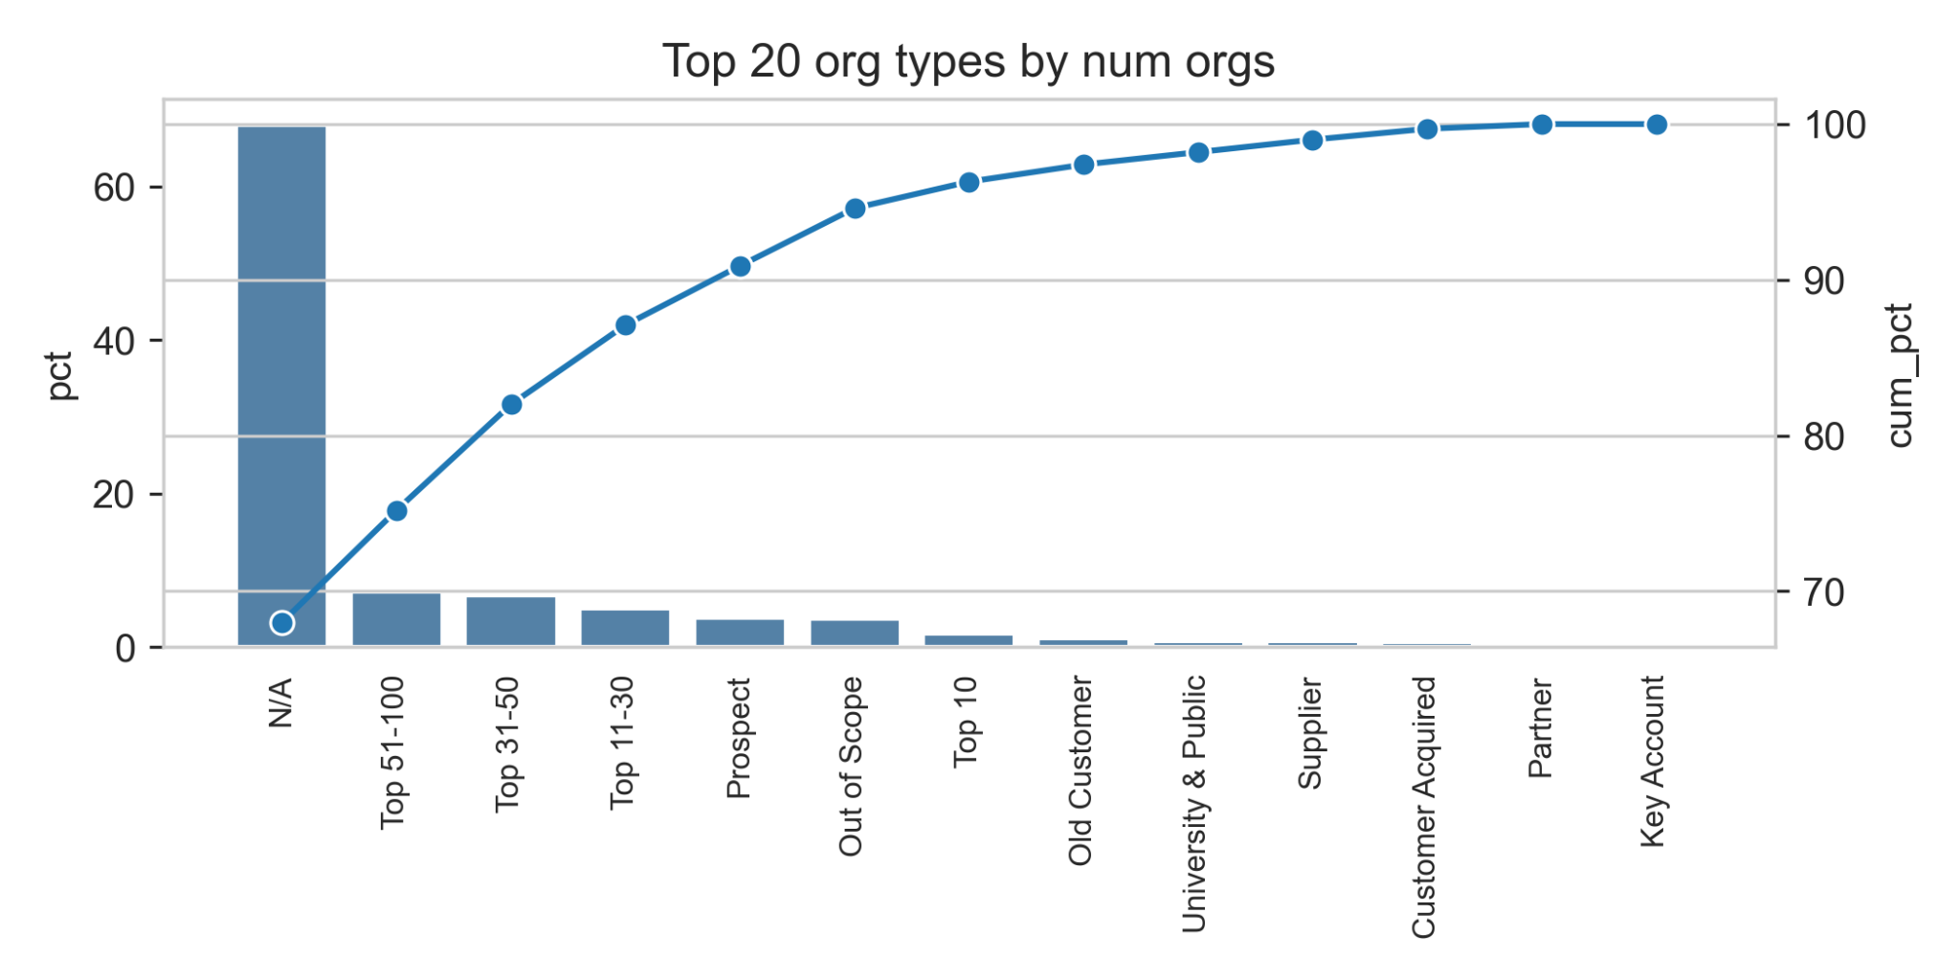
Top organization types
Notes:
Most of the company are unranked (we assume)

Slide 42
Analysis of Candidates and Employment

Slide 43
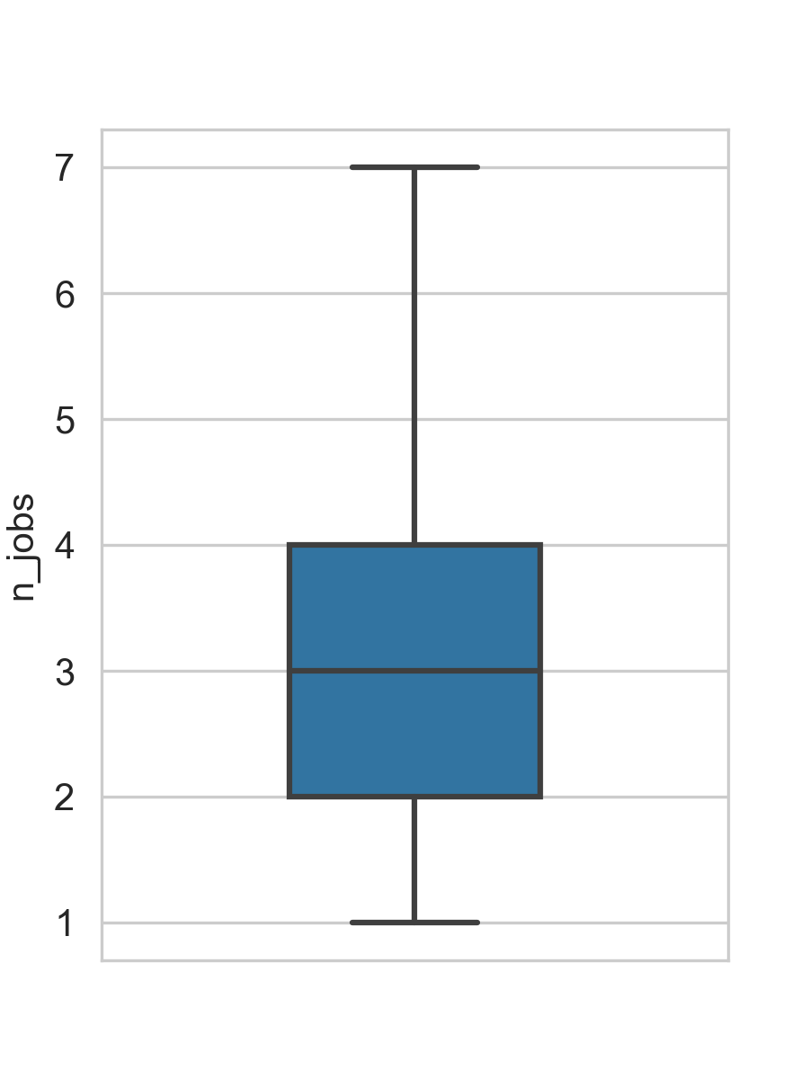
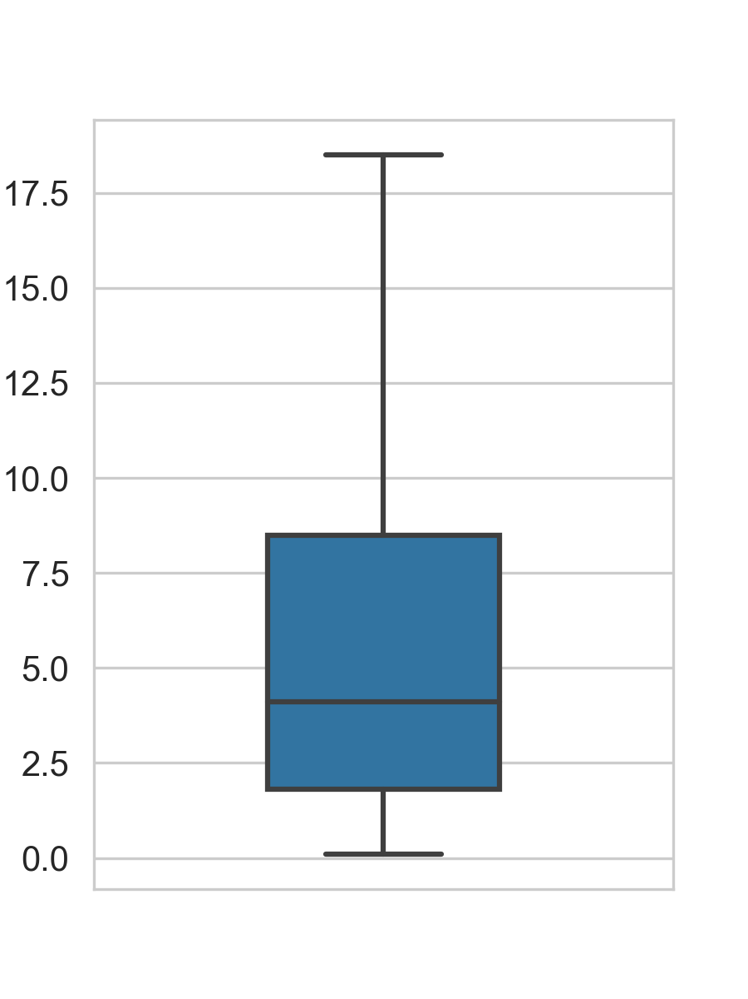
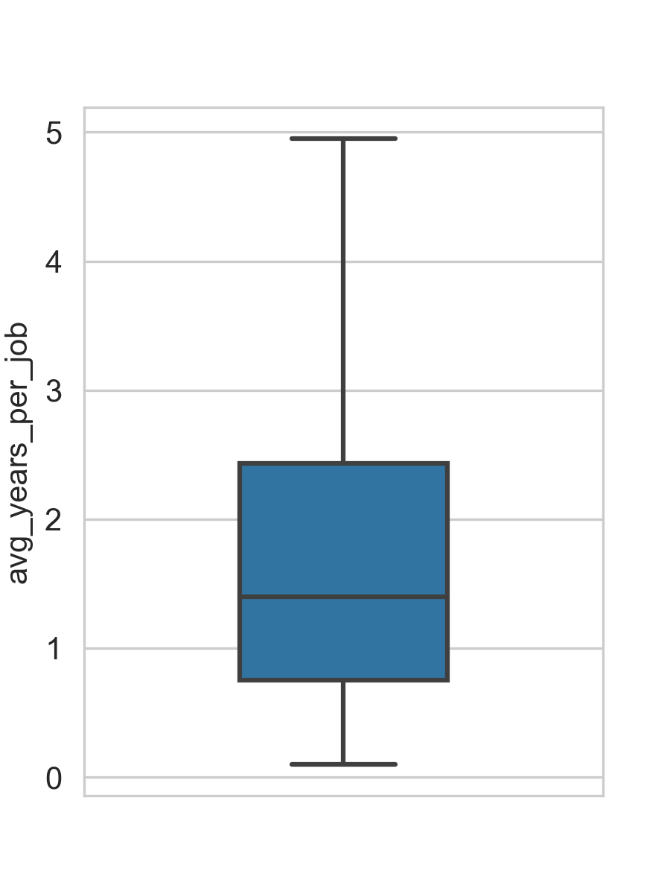
Summary stats of experience
t
Num jobs Total years of exp Avg. years per job
Notes:
Fluctuates a lot, 50% of the candidates change job in between 2.5 year (high turnover)

Slide 44
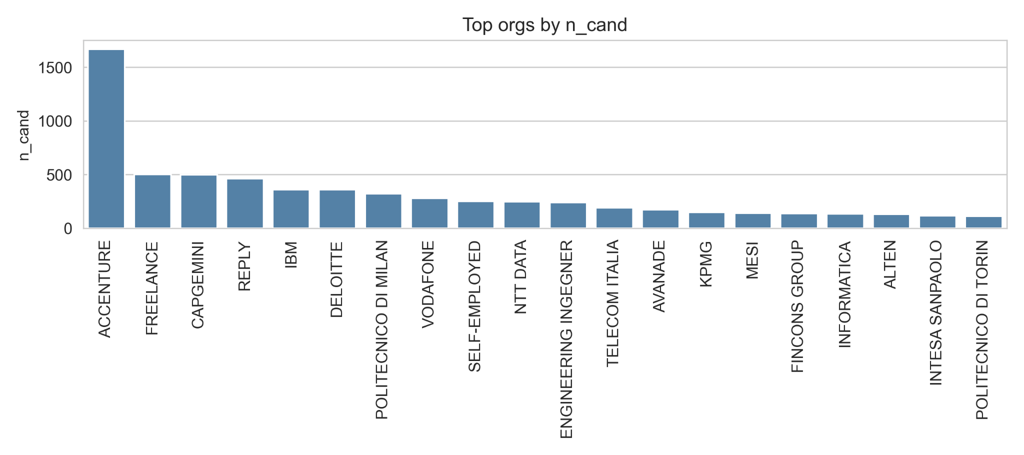
Top organizations by num candidates (full History)
Notes:
Big consultancy companies

Slide 45
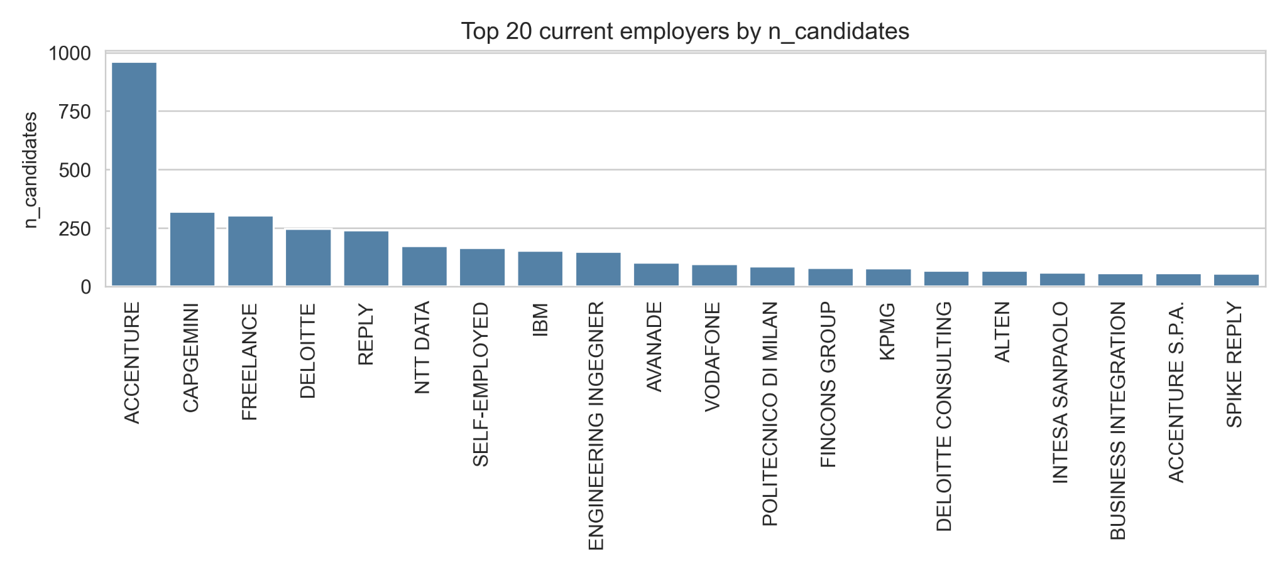
Top current employers by num candidates

Slide 46
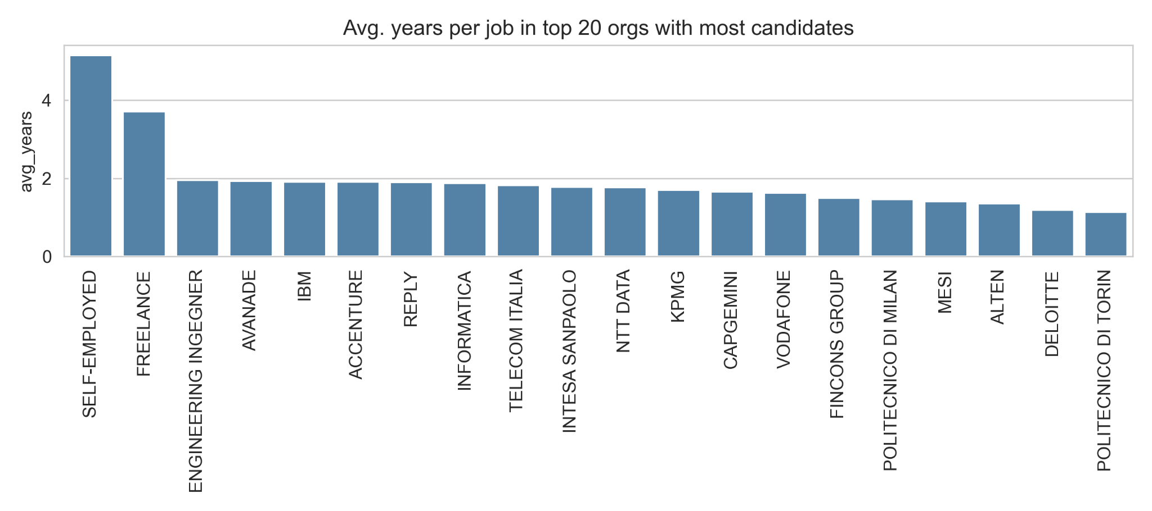
Avg. years per job of orgs with most candidates
Notes:
Working for companies: quick turnover (consistent w/ previous finding)

Slide 47
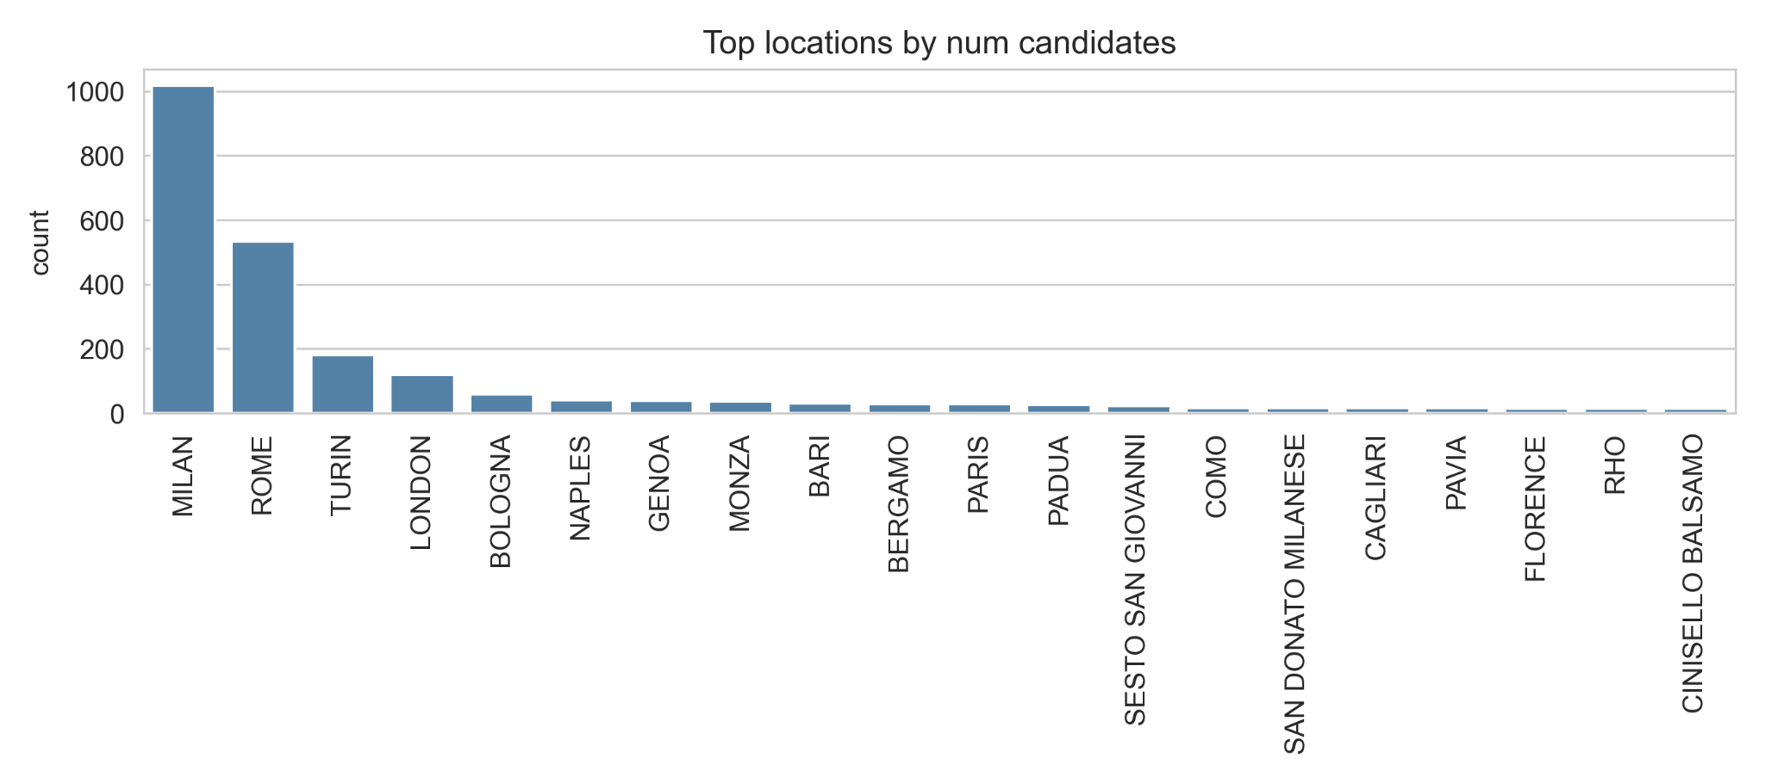
Top cities most candidates come from
Notes:
Ppl apply for the cities they’re already in

Slide 48
Regression analysis

Slide 49
Explaining salary
Model
Adjusted R-squared: 0.134
Coefficients & p-values: next slide
Notes:
NB: we try explain salary not predict it
Good_eng = proficient or native
Job_reason = increase in headcount (chosen as reference group), transfer, replace
R-square very low but that’s real life

Slide 50
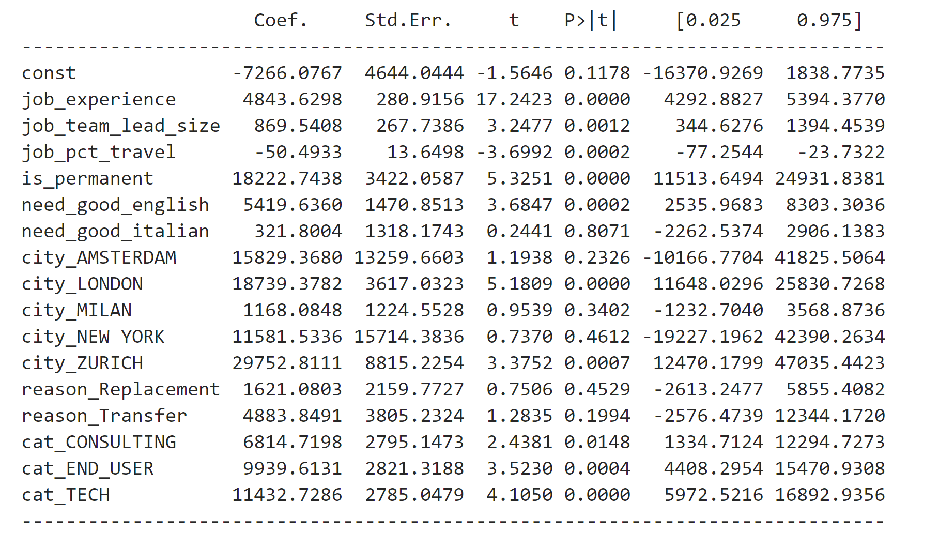
To be updated
Notes:
English significan, italian it’s not
Clarify why the pct_travel has a negative beta
London expect to earn more
Milan: u get the same money like other cheaper italian cities
Sample size it’s an issue for the other cities (maybe not for Zurich)
Categories: significant (reference group: other)

Slide 51
Job / candidate clustering and matching

Slide 52
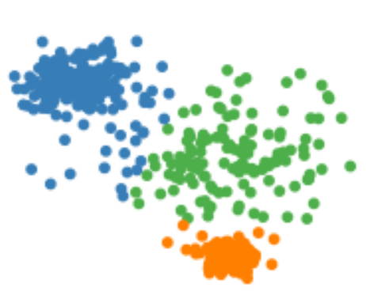
Job/candidate clustering
Desired skills
BIG DATA;HADOOP;HIVE;HBASE
APPS;MOBILE;NODEJS;JAVASCRIPT;API
TF-IDF
K-Means
Notes:
Desired skills from job matching w/ the candidate skills
TF-IDF: track some features from skills and feed it to k-means

Slide 53
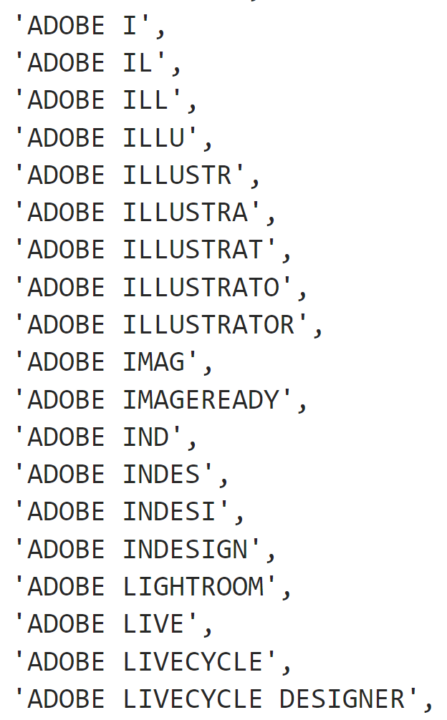
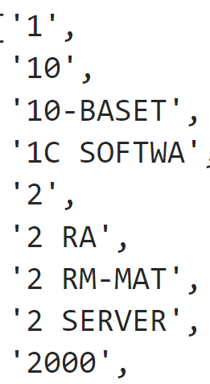
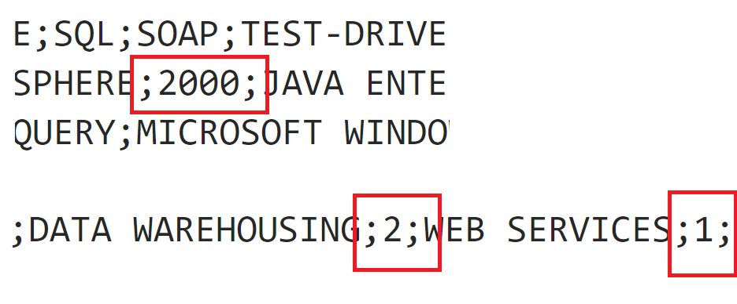
Noisy data

Slide 54
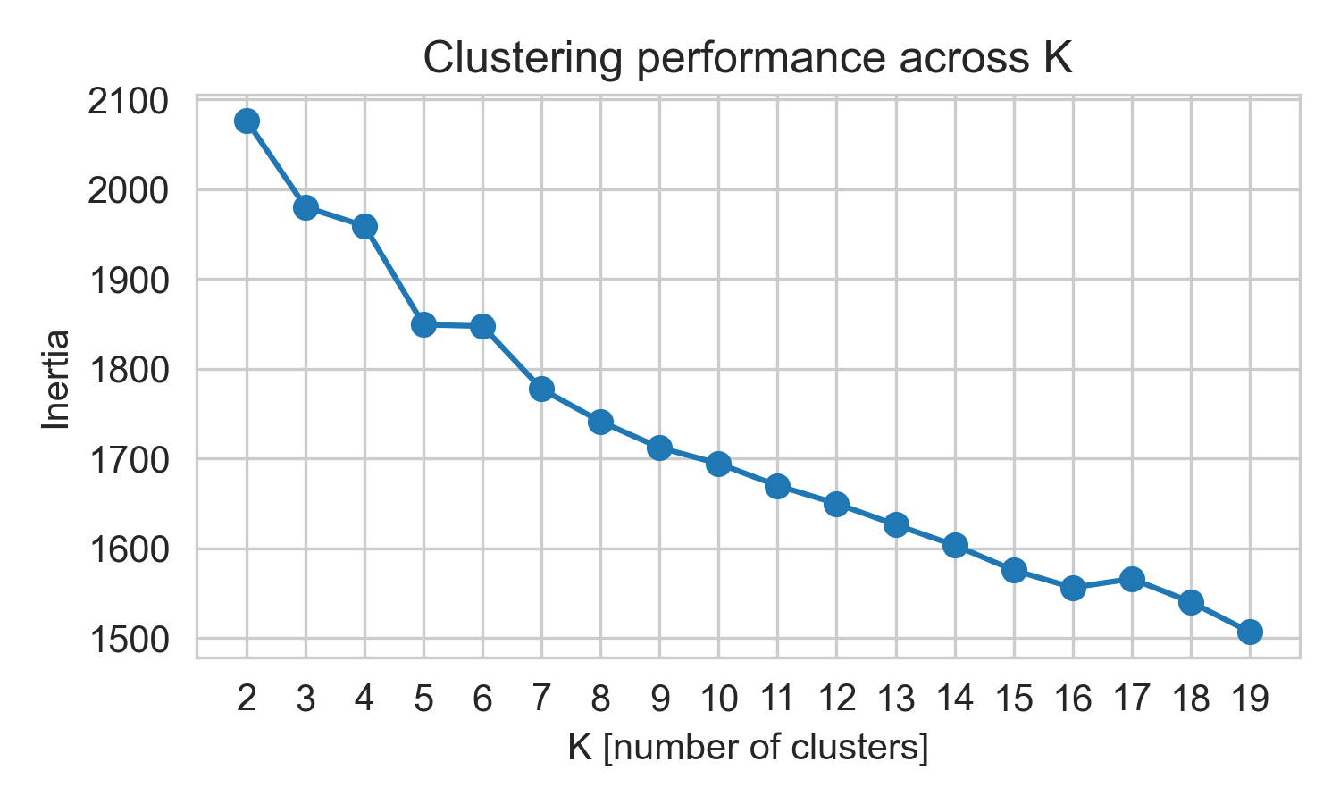
Job clustering (1)
Num jobs 4,590
Num jobs with desired skills 2,458
Notes:
Ideal number of clusters around 5

Slide 55
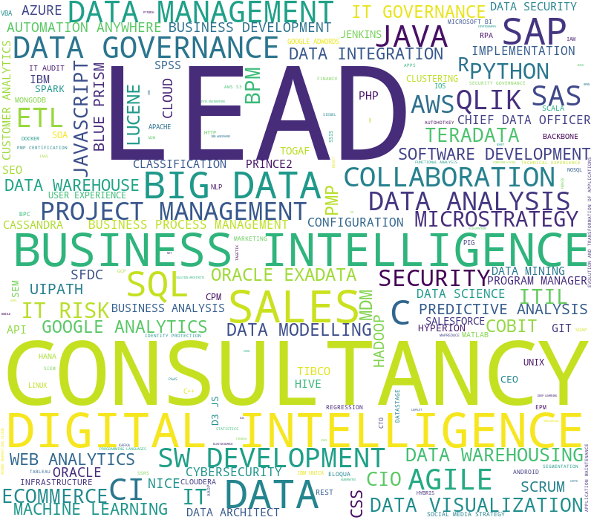
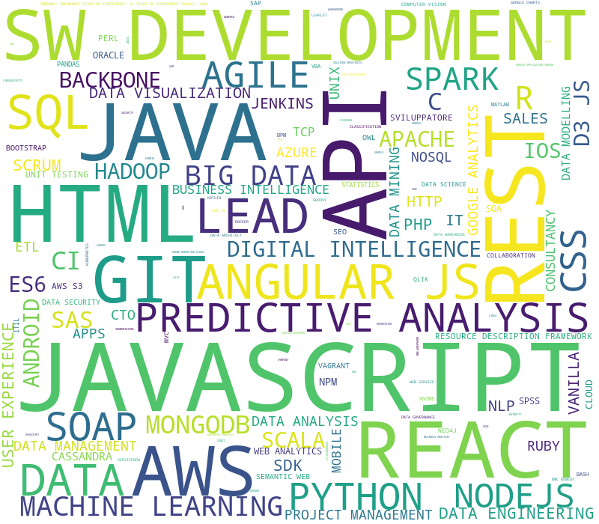
Job clustering (2)
IT Consultancy
Web / SW Development

Slide 56
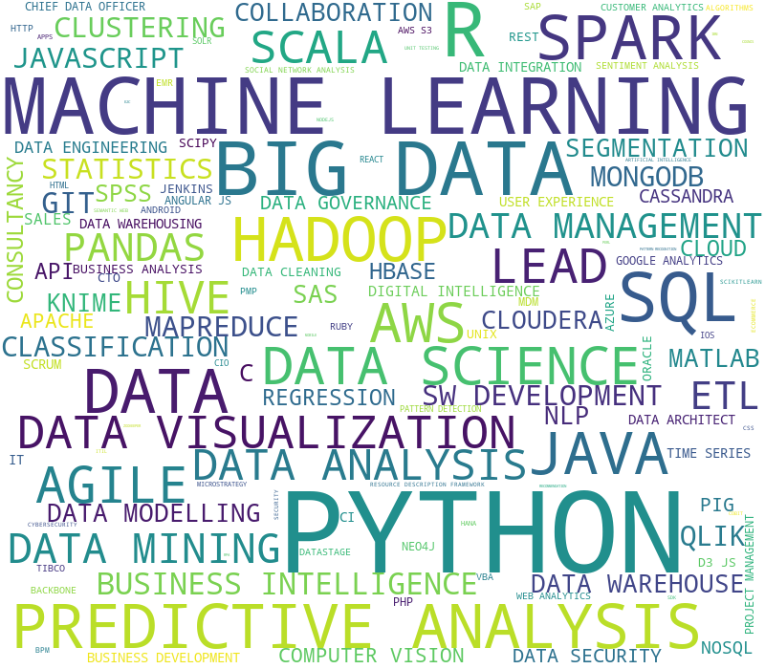
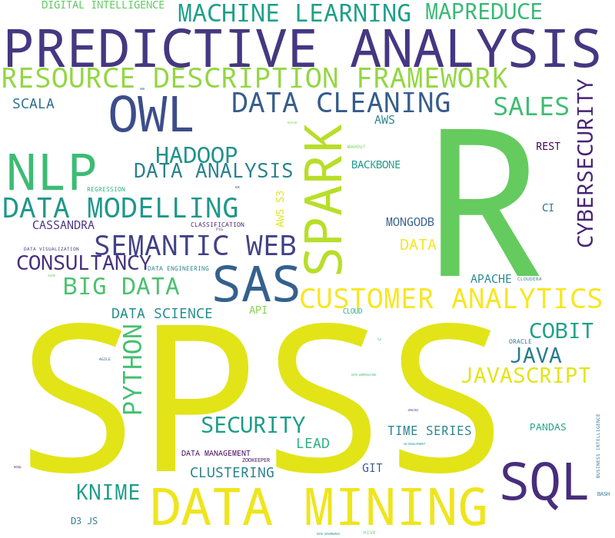
Job clustering (3)
Data Science & Engineering
Data Analytics

Slide 57

Job clustering (4)
Network & Security

Slide 58
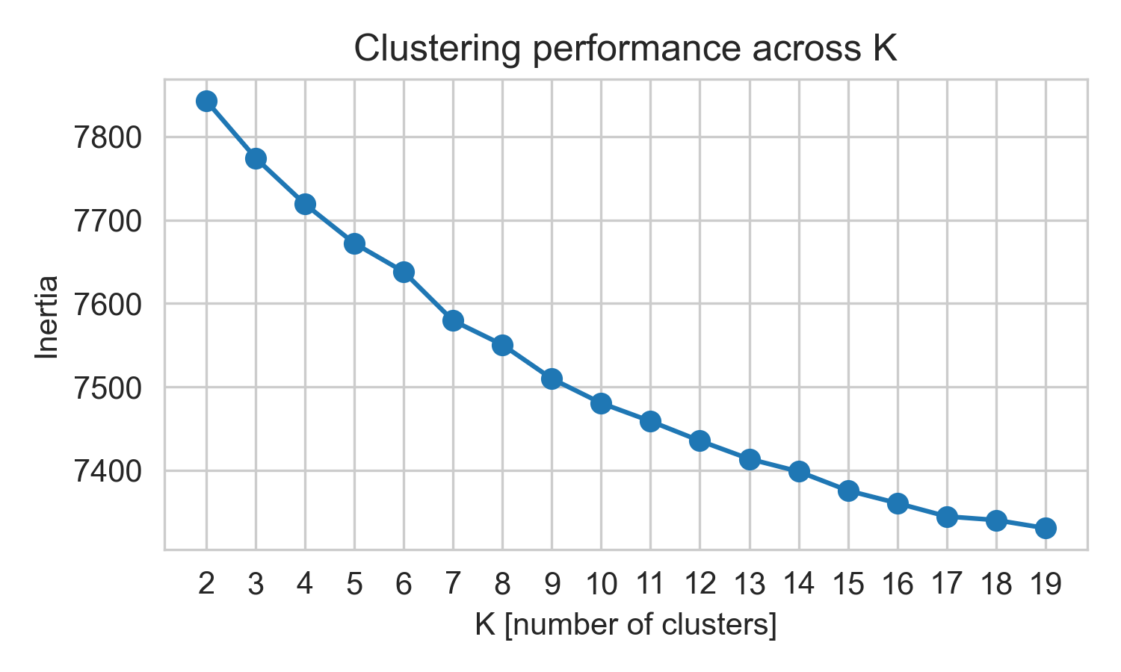
Candidate clustering (1)
Num candidates 54,414
Num candidate with IT skills 8,290
Notes:
Optimal k: 7

Slide 59
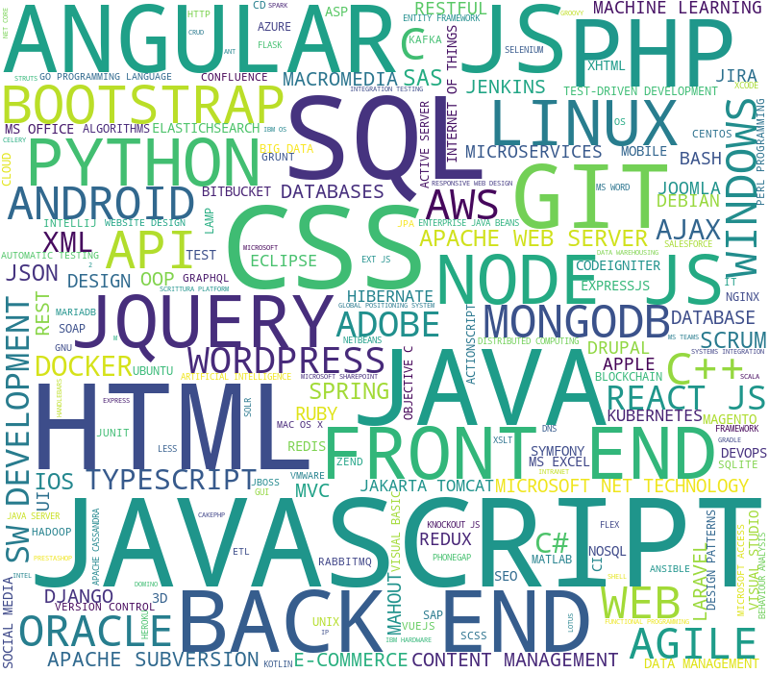

Candidate clustering (2)
Web Developers
Regular Office Workers

Slide 60


Candidate clustering (3)
Data Modelers
System Engineers

Slide 61


Candidate clustering (4)
Java SWE
.Net SWE
Notes:
.Net: work w/ Window

Slide 62

Candidate clustering (5)
Data Scientists & Engineers
Notes:
ETL: extract transform and load

Slide 63
Job / candidate matching
Candidate
Candidate
(CV)
Candidate type
Clustering
Matching
Job
(Description)
Job
type
Clustering

Slide 64
Future work

Slide 65
Ideas for future work
Problems | Application
Predict if a candidate will pass the screening round and proceed to the 1st interview based on the match between candidate CV and job details | Automatically evaluate and rank candidates based on probability and prioritize which candidates to forward to hiring clients first
Predict the duration that a candidate will stay with the company based on their employment history | Helpful indicator to match the candidate with jobs that require long-term commitment

Slide 66
Q & A

